Slide 1

ECONOMIC AND REVENUE REVIEW AND UPDATE
Briefing for New college and university Board of Visitors Members
Stephen E. Cummings
Secretary of Finance
Commonwealth of Virginia
www.finance.virginia.gov
October 2022
Notes:
Take away messages:
Just completed period of revenue growth
A lot accomplished. We are well-positioned.
Higher ed has benefitted.
Outlook uncertain/deteriorating.
Upcoming process is different with more detailed review and challenges – tighter $ available.

Slide 2
TOPICS FOR DISCUSSION
Economic Review
Fiscal Year 2022 Year-In-Review
Update on Budget Process
September Year-to-Date Revenue Collections, Fiscal Year 2023

Slide 3
summary
Strong financial results in FY 2022 = $3.2 billion surplus.
  $1.9 billion from unplanned revenues.
  $1.2 billion from spending below appropriations.
Conservative forecasting at time of mid-session revenue forecast and solid first quarter FY 2023 results provide a cushion in the face of an uncertain economic outlook.
Balance sheet is in an extremely strong position. Combined balances in reserve funds will be $4.3 billion by year-end FY 2024, more than 15% of revenues.
Other budget actions have been taken to provide further future budget flexibility.
Persistently high inflation, rising interest rates, and volatility in the financial markets have the potential to slow revenue growth. The revenue outlook will be adjusted through the traditional revenue forecasting process currently underway.

Slide 4
USE OF $3.2 BILLION OPERATING SURPLUS
Sources of Surplus
 | Unplanned Revenues Above Chapter 1 Forecast | $1.9 | B
 | Spending Below FY 2022 Appropriations | $1.2 | B
 | Total | $3.2 | B
Uses of Surplus
 | Balance of Rainy Day Fund Deposit¹ | $0.4 | B
 | Spending Contingent on Unplanned Revenues | $0.6 | B
 | Potential Rainy Day Fund "Super” Deposit | $0.5 | B
 | Reappropriations Required by General Assembly | $0.8 | B
 | Reappropriations at Discretion of Governor | $0.4 | B
 | Water Quality Improvement Fund Deposit | $0.1 | B
 | Voluntary Taxpayer Relief | $0.4 | B
 | Total | $3.2 | B
¹--Reflects impact of General Assembly prepayment of $498.7 million of the calculated $904.7 million required deposit.
Notes:
This is how the cash surplus is allocated on the year-end balance sheet:
$1.1 billion of the surplus is directed to revenue reserves and shoring up the Virginia Retirement System—not including the $499 million prepayment of the 2024 Rainy Day Fund deposit,
$1.1 billion goes towards appropriations mandated by the General Assembly and contingent appropriations added in the caboose budget,
$397 million is set aside for tax relief in next year’s budget,
$380 million is available for reappropriation by the Governor (decisions to be made in the coming months), and
$131 million goes to the Water Quality Improvement Fund.

Slide 5
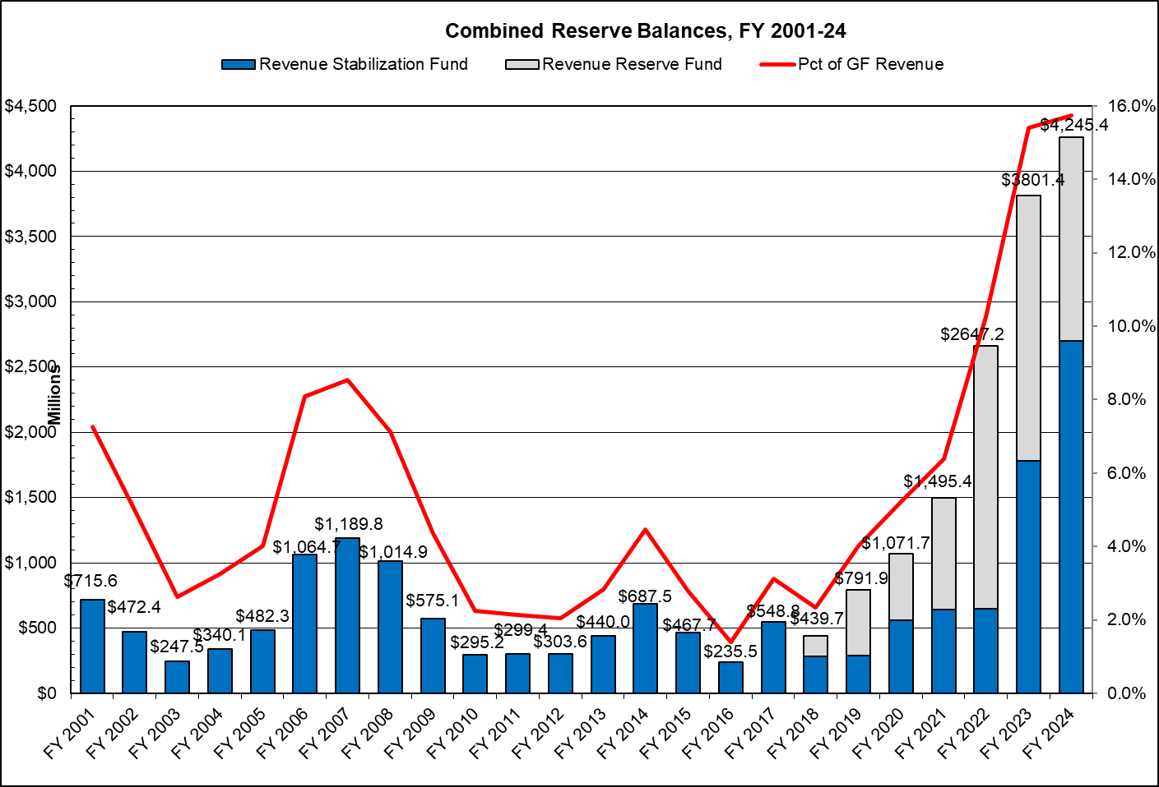
COMBINED RESERVE BALANCES PROJECTED TO TOTAL NEARLY $4.3 BILLION BY FISCAL YEAR 2024
Notes:
Reserve balances are strong. By the end of FY 2024, combined balances in the Rainy Day Fund and Revenue Reserve Fund will total nearly $4.3 billion, more than 15% of revenues.

Slide 6
BALANCE SHEET IS IN EXTREMELY STRONG POSITION
The balances in both the Water Quality Improvement Fund (WQIF) and Transportation Trust Fund (TTF) have grown significantly in recent years.
  WQIF FY 2022 year-end balance totaled $113.3 million, a 228 percent increase over FY 2019.
  TTF FY 2022 year-end balance totaled $2.7 billion, a 66 percent increase over FY 2019.
$830 million of one-time contributions to the Virginia Retirement System (VRS) to reduce unfunded liabilities.
$2.7 billion 2022-2024 capital program funded entirely through cash.
Capital project expenditure cost overruns pre-funded with $450 million pool.
$470 million for Interstate 64 widening included in the budget, including $150 million contingent funding.
Repeal of Accelerated Sales Tax, potential value over $200 million.

Slide 7
STATE SUPPORTED CAPITAL EXPENDITURES, FY 2013-22
State-supported funding includes general fund, Virginia College Building Authority (VCBA) bonds, and Virginia Public Building Authority (VPBA) bonds.
Source: Virginia Department of Planning and Budget.

Slide 8
Fiscal year 2022 recap: 36 PERCENT GF Growth
FY 2019-22
Strong growth in all revenue sources have led to a 36 percent General Fund increase versus 2019.
Strong wage growth provides a strong base from the largest source of revenues.
Nonwithholding represents the largest growth in dollars and is the largest risk to our projections.
General Fund Revenue Collections
(in millions of dollars)
 |  | Actuals |  |  |  |  |  | FY 2019 - FY2022 |  |  |  | FY 2021 - FY2022
Revenue |  | FY 2019 |  | FY 2021 |  | FY 2022 |  | Change |  | % Change |  | Change |  | % Change
Withholding |  | $12,987.9 |  | $14,012.9 |  | $15,340.3 |  | $2,352.4 |  | 18.1% |  | $1,327.4 |  | 9.5%
Nonwithholding |  | 3,976.8 |  | 5,217.0 |  | 6,810.5 |  | 2,833.7 |  | 71.3% |  | 1,593.5 |  | 30.5%
Refunds |  | (1,738.2) |  | (1,926.2) |  | (1,740.5) |  | (2.3) |  | 0.1% |  | 185.7 |  | -9.6%
Sales |  | 3,580.4 |  | 4,166.2 |  | 4,558.1 |  | 977.7 |  | 27.3% |  | 391.9 |  | 9.4%
Corporate |  | 943.4 |  | 1,515.7 |  | 1,978.7 |  | 1,035.3 |  | 109.7% |  | 463.0 |  | 30.5%
All Other |  | 1,557.2 |  | 1,892.9 |  | 1,987.8 |  | 430.6 |  | 27.7% |  | 94.9 |  | 5.0%
Total GF Revenues |  | $21,307.5 |  | $24,878.5 |  | $28,934.9 |  | $7,627.4 |  | 35.8% |  | $4,056.4 |  | 16.3%
GF Transfers |  | $658.0 |  | $758.60 |  | $814.30 |  | $156.30 |  | 23.8% |  | $55.7 |  | 7.3%
Total General Fund |  | $21,965.5 |  | $25,637.1 |  | $29,749.2 |  | $7,783.7 |  | 35.4% |  | $4,112.1 |  | 16.0%
Notes:
Overall, revenues are up almost 36% over the past three years with growth across all major revenue components, as well as lower than expected refunds in the most recent fiscal year.
Our largest source of revenues, personal income tax withholdings is up 18% since FY2019, over half of that increase occurred between FY21 and FY22. We will discuss this in some detail later, but rising labor income is the dominant driver of these gains.
Non-withholding income taxes has been surprisingly strong reflecting stock market driven capital gains, increasing non-wage labor income, and other sources.
Corporate income taxes more than doubled over the past three years.
Finally, sales taxes have been rising with strong consumer demand coming out of the Covid pandemic, boosted by price inflation.
Our revenue picture suggests that we can look for ways to help taxpayers and boost real economic growth while maintaining a healthy balance sheet for the Commonwealth.

Slide 9
FY 2023 YEAR-TO-DATE: ADJUSTED FOR TAXPAYER REBATES AND AST REPEAL, GF REVENUES ARE UP 7.6 PERCENT
After the rebate, withholding, and AST adjustments are accounted for, GF revenues are up 7.6 percent fiscal year-to-date.
Payroll withholding is up 9.6 percent.
Sales and use tax collections are up 5.7 percent.
Corporate income tax collections are down 5.2 percent.
Notes:
September completes the first quarter of Fiscal Year 2023 and is a significant month for revenue collections. Estimated payments from individuals, corporations, and insurance companies are all due in September, along with regular monthly collections in withholding, sales taxes, and other sources.
Adjusted for policy actions, including taxpayer rebates and the repeal of Accelerated Sales Tax (AST), first quarter general fund revenues were up 7.6 percent. On an unadjusted basis, revenues declined 5.0 percent for the quarter versus the 14.0 percent decline assumed in the current budget.
The 14.0 percent projected decline in revenues for FY 2023 reflects the conservative decision not to change the FY 2023 revenue outlook when the February midsession forecast adjustment was made, and includes the impacts of tax relief measures enacted during the 2022 General Assembly (including $1 billion in tax rebates issued beginning in late September and approximately $1 billion resulting from the increase in the standard deduction).
September year-over-year general fund revenues declined by 28.4 percent for the month, reflecting the issuance of $895.9 million in taxpayer rebates. Adjusting for the taxpayer rebates and the timing of payroll withholding deposits, general fund revenues grew 10.7 percent.

Slide 10
THE JOB MARKET REMAINS STABLE
Source: Federal Reserve Bank of Saint Louis; Bureau of Labor Statistics

Slide 11
INFLATION IS TAKING MORE OF FAMILIES’ PAYCHECKS
Food
13.5%
All Items
8.2%
Source: Average Hourly Earnings of All Employees, Total Private; Consumer Price Index for All Urban Consumers; Bureau of Labor Statistics

Slide 12
OTHER ECONOMIC DATA ARE MIXED
-24.7%
30-Year Mortgage
-16.5%
2-Year Treasury
Fed
Funds
Source: Federal Reserve Bank of Saint Louis; Bureau of Labor Statistics, Virginia Association of Realtors

Slide 13
U.S. RECESSION IS INCREASINGLY LIKELY
Recent economic forecasts are increasingly predicting a U.S. recession.
The Conference Board forecasts that economic weakness will intensify and spread more broadly with a recession to begin before the end of calendar year 2022. This outlook is associated with persistent inflation and rising hawkishness by the Federal Reserve.
The IHS Markit October standard forecast assumes a mild recession beginning in the fourth calendar quarter of 2022 with a weak recovering beginning in the second half of calendar year 2023.
FORECAST
Source:- The Conference Board (Oct 12, 2022); IHS Markit, October Standard Forecast.
Notes:
Note: The WSJ survey of economists, published October 16, now puts the probability of recession in the next 12 months at 63%, up from 49% in the July survey. It is the first time the survey pegged the probability above 50% since July 2020.

Slide 14
CONCLUSION
September completes the first quarter of FY 2023. Adjusted first quarter general fund revenues were up 7.6 percent, with continued growth in all significant revenue streams.
Recent economic data suggest an increasing likelihood of a U.S. recession:
  The job market remains stable while employment and wage growth support continued growth in withholding collections in the near term.
  However, rapidly rising interest rates and high inflation are likely to dampen demand leading to reduced corporate profits and slowed job growth in the next 12 to 24 months.
  While sales tax collections continue to exceed prior year totals, persistent inflation and lower consumer sentiment have the potential to impact spending in coming months.
  Volatility in the financial markets highlights uncertainty around nonwithholding collections.
The revenue forecast will be adjusted as part of the normal fall forecasting process to reflect current expectations with input from JABE and GACRE.
The balance sheet of the Commonwealth has never been in a stronger position.

Slide 15
THE PROCESS FOR DEVELOPING BUDGET AMENDMENTS FOR THE 2023 GENERAL ASSEMBLY SESSION IS IN FULL SWING
September: Agency operating budget amendments reviewed by Cabinet and submitted to DPB for further analysis.
October:
DPB provides initial analysis of agency recommendations.
Governor’s Office and Finance Secretariat triage agency recommendations and develop further policy options for the Governor’s consideration.
Joint Advisory Board of Economists reviews economic projections for current and next biennium.
November:
Medicaid forecast finalized.
Governor’s Advisory Council on Revenue Estimates reviews revenue forecast for the 2022 - 2024 biennium.
Preliminary decisions made on allocation of available resources.
December:
General fund revenue forecast finalized.
Final decisions made on allocation of available resources.
Governor Youngkin’s amendments to the 2022 - 2024 budget are presented to the Joint Money Committee on December 15.
Notes:
To wrap up, we have already begun our fall forecasting process that will continue through December.
The Governor convened a meeting of the Governor’s Advisory Council on Revenue Estimates in August.
JABE met on October 12
With advice of GACRE, we
will continue to work in the next few months to update the revenue estimates in preparation for the 2023 General Assembly session.

