Slide 1
2022 Boards of Visitors Orientation: Trusteeship 101 The Role of a Public Trustee: Resources and Ideas
Michael Poliakoff, Ph.D.
President, the American Council of Trustees and Alumni (ACTA)
October 18, 2022

Slide 2
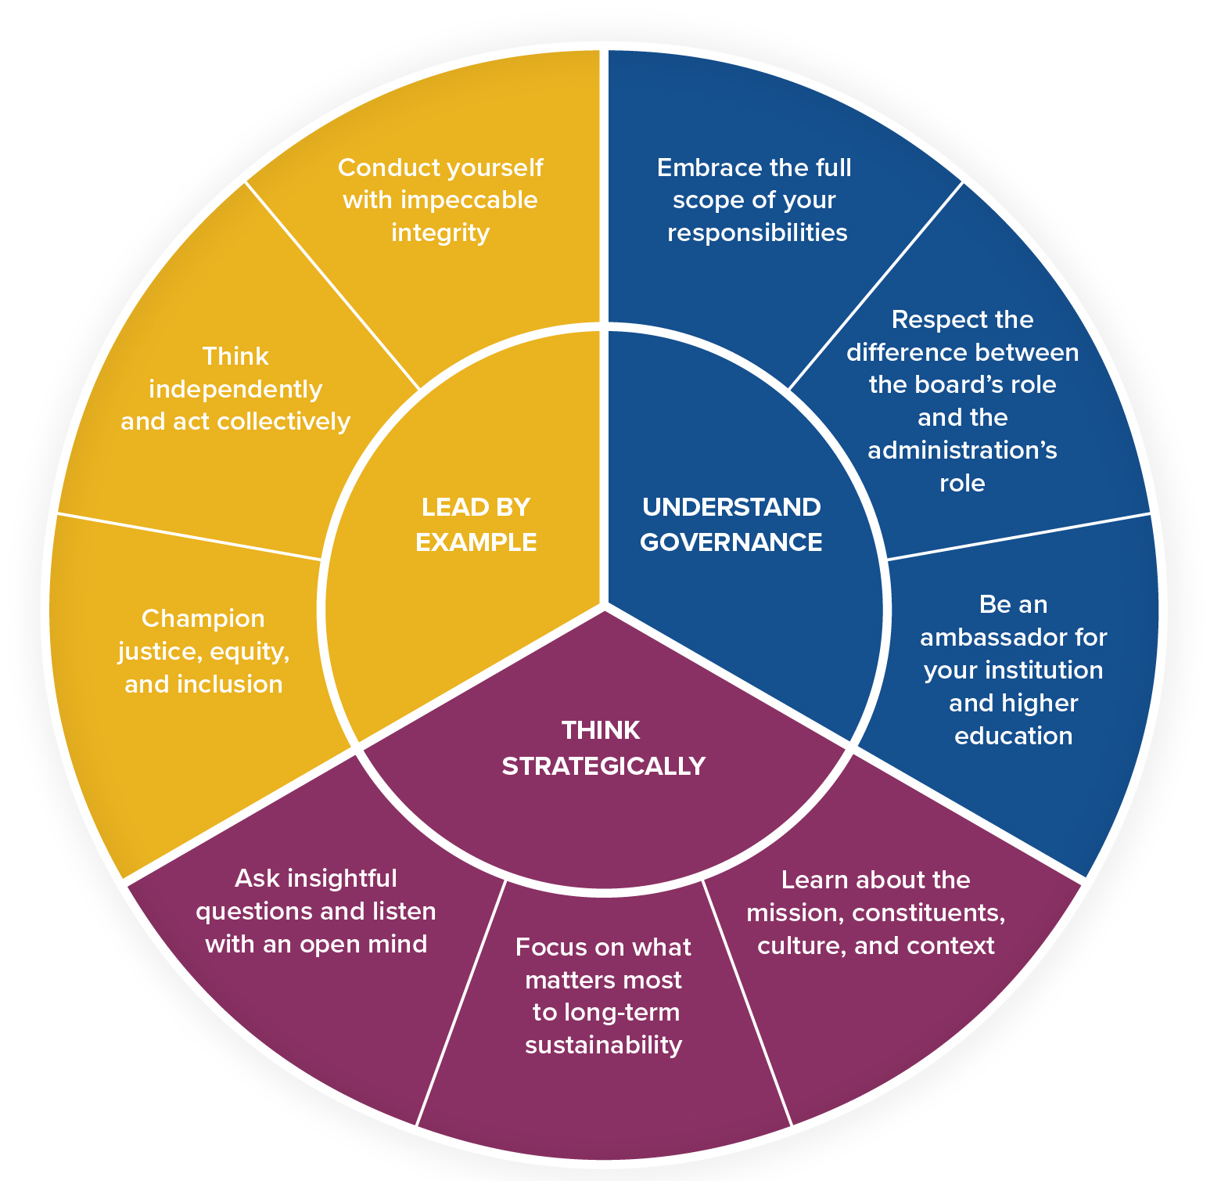
Principles of Trusteeship – Pie chart
NEED GRAPHIC HERE

Slide 3
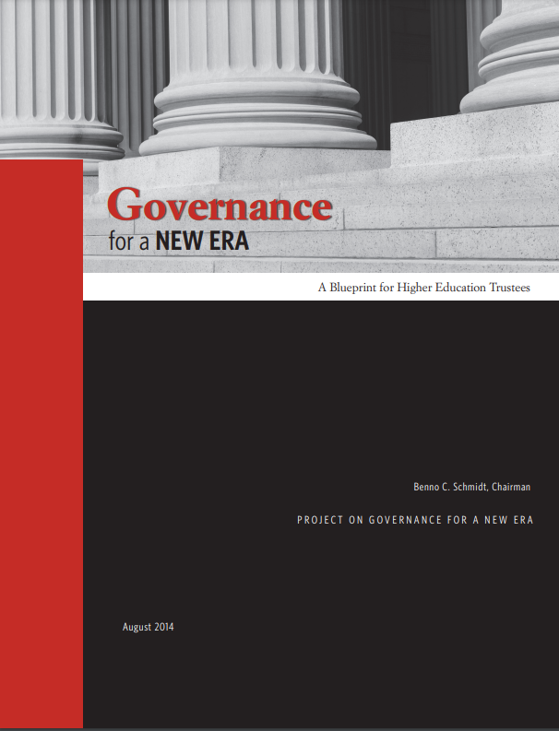
Governance for a New Era: A Blueprint for Higher Education Trustees

Slide 4
Virginia § 23.1-1304. Governing boards; additional duties; educational programs
B. Educational programs for the governing boards of public institutions of higher education shall include presentations relating to:
1. Board members' primary duty to the citizens of the Commonwealth…

Slide 5
State University System of Florida Accountability Plan

Slide 6
State University System of Florida Accountability Plan

Slide 7
HowCollegesSpendMoney.com
Free for the public, designed for trustees
Data from over 1,500 four-year public and private colleges
Nine years of data
Spending, tuition, enrollment and other information

Slide 8
General Education at
Virginia’s Public Colleges and Universities

Slide 9
What Will Students Learn in the Classroom?
ACTA’s What Will They Learn?® project grades the core curricula at colleges and universities on an “A” through “F” scale based on how many of the seven WWTL subjects they require students to study. This year, only 22 of over 1,100 colleges earned an “A” require at least six of the seven subjects.
The What Will They Learn Subjects Areas
Composition
Foreign Language
Literature
U.S. Government & History
Economics
Mathematics
Natural Science

Slide 10
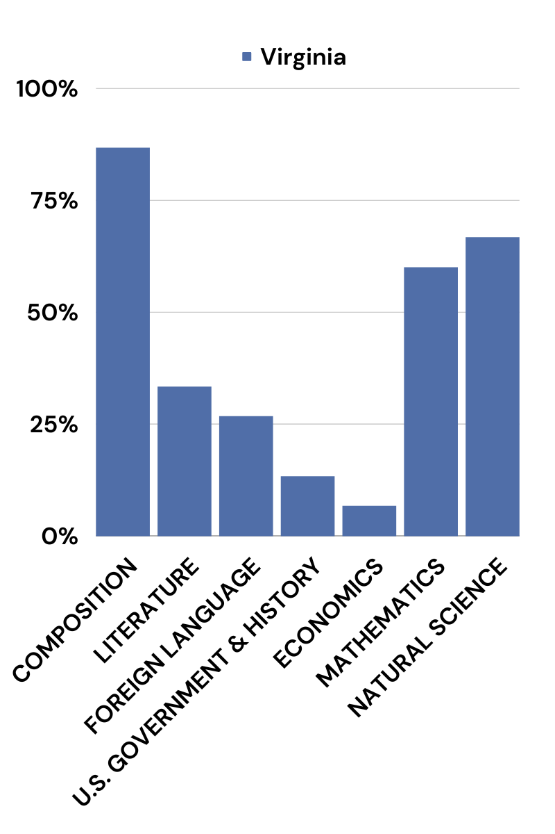
Virginia Public Schools’ General Education: Subject Areas Required

Slide 11
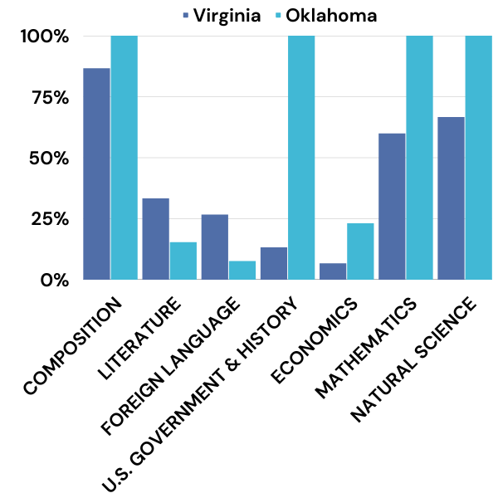
Virginia Public Schools’ General Education: Subject Areas Required vs. Oklahoma

Slide 12
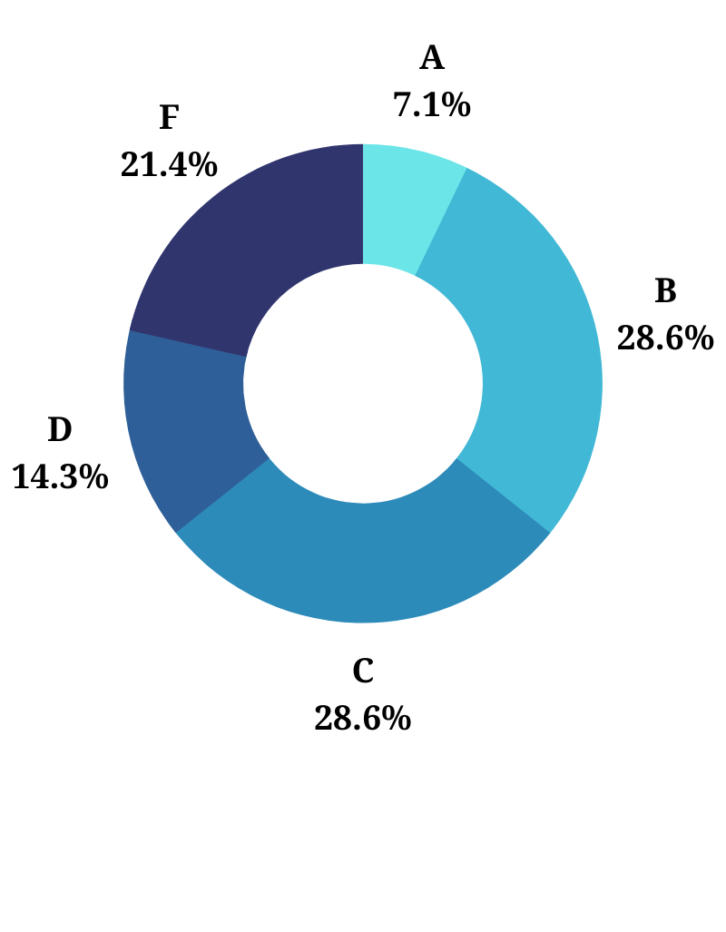
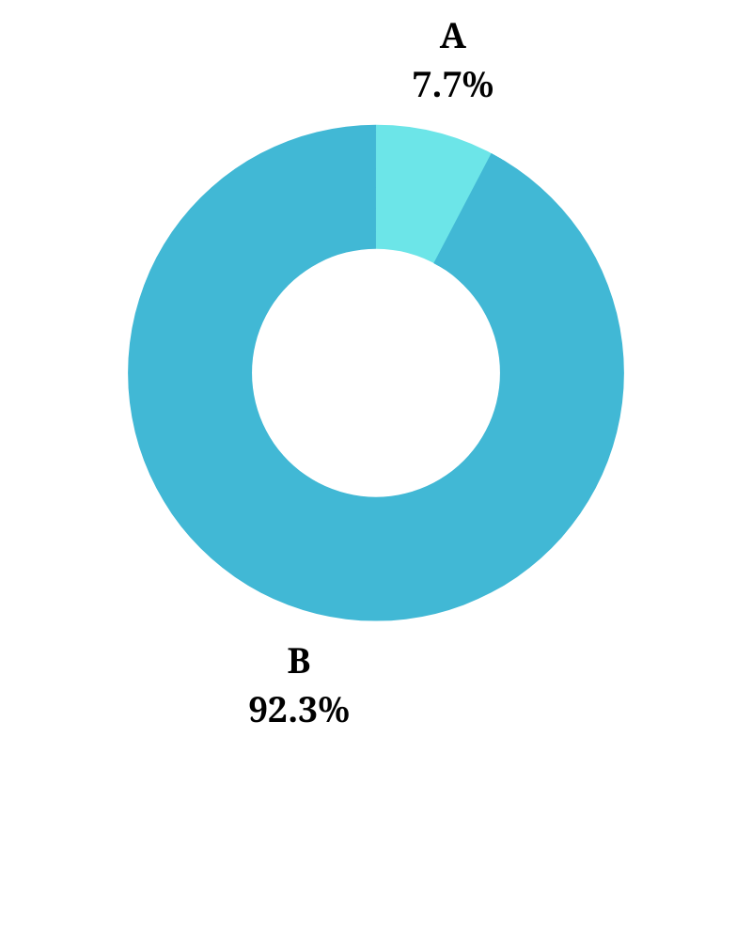
Virginia Public Schools’ Core Curriculum
Virginia’s Average Grade: D+
(2.93/7 subject areas required)
Oklahoma’s Average Grade: B
(4.46/7 subject areas required)

Slide 13
Virginia Public Schools’ General Education

Slide 14
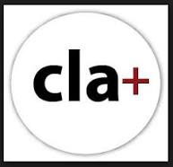
Collegiate Learning Assessment (CLA+) and Success Skills Assessment (SSA)
“The performance-based CLA+ and SSA+ provide insightful, nuanced evidence of students’ competencies in these areas so they and their instructors can work to develop these essential skills.”

Slide 15
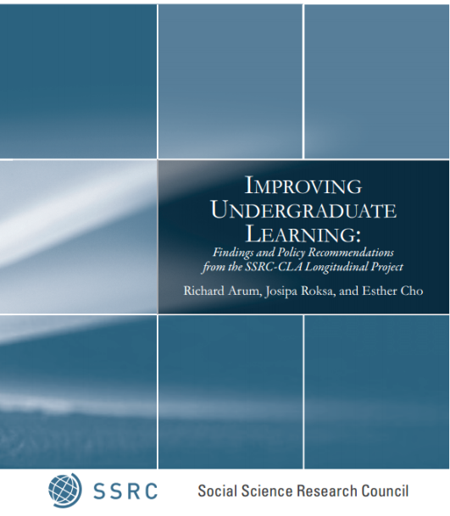
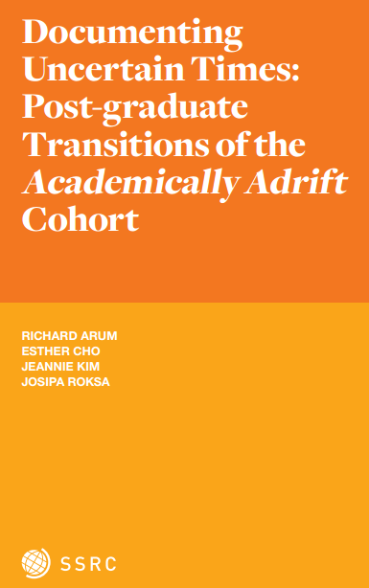
Richard Arum and Josipa Roksa, Academically Adrift
Class of 2009: 36% with no significant cognitive gain.
“There is more variation within institutions than across institutions…., high- and low-performing students can be
found at each institution and within each level of selectivity”
Notes:
Lowest performers most likely to be unemployed, living at home, and in credit card debt after graduation.

Slide 16
Addressing College Drinking and Drug Use: A Primer for Trustees, Administrators, and Alumni

Slide 17
ACTA Gold Standard for Freedom of Expression

