Slide 1
Overview of
Virginia Higher Education
Boards of Visitors Orientation
October 18, 2022
Peter Blake, Director
Katharine Webb, Vice Chair

Slide 2
Virginia Higher Education Landscape
15
30
PRIVATE NONPROFIT COLLEGES AND UNIVERSITIES
PUBLIC FOUR-YEAR INSTITUTIONS
24
300+
PUBLIC TWO-YEAR INSTITUTIONS
(23 COMMUNITY COLLEGES + 1 TRANSFER COLLEGE)
FOR-PROFIT, OUT-OF-STATE OR VOCATIONAL INSTITUTIONS
5
HIGHER EDUCATION CENTERS

Slide 3
Virginia Higher Education Landscape
124,227
70.5%
DEGREES & CERTIFICATES AWARDED IN 2021
PUBLIC FOUR-YEAR GRADUATION RATE (2nd IN NATION)
517,438
$51,897
ENROLLED FALL 2021
MEDIAN WAGES, 5 YEARS AFTER BACHELOR’S DEGREE
$10 billion
$30,574
ANNUAL HIGHER EDUCATION EXPENDITURES
MEDIAN DEBT UPON GRADUATION FOR BACHELOR’S DEGREE

Slide 4
Benefit to Individuals & Communities
Individuals with an associate degree or higher are…..
38% more likely to have health benefits
79% more likely to volunteer
30% more likely to vote in an election
…than individuals with a high school diploma
Source: It’s Not Just the Money, Lumina Foundation
https://www.luminafoundation.org/resources/its-not-just-the-money

Slide 5
State Return in Investment
“Every dollar spent on public higher education by the state is associated with an additional $1.92 in state revenue and an increment of $21.32 to Virginia’s gross domestic product.”
“Study of the Growing Economic Impact of Virginia Public Higher Education”
Weldon Cooper Center for Public Service
February 2017

Slide 6
Governance Roles in Higher Education

Slide 7
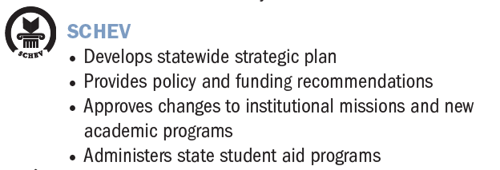
Governance Roles in Higher Education

Slide 8
Governance Roles in Higher Education
STATE COMMITTEES
Six Person Operating Advisory Committee (OpSix) reviews and provides feedback on institutions’ six-year operating plans
Six-Year Capital Outlay Plan Advisory Committee (6PAC) reviews institutions’ six-year capital plans and makes recommendations to The General Assembly

Slide 9
State Council of Higher Education
Coordinating body for Virginia higher education
Approval authority for certain academic matters at public institutions
Advisory services to certain private, nonprofit institutions
Regulatory authority for certain private, for-profit and out-of-state institutions
Various specific statutory duties, including
“Educational programs” for appointees to public institutions’ governing boards
Statewide strategic plan, at least every six years

Slide 10
Educational Programs for New Boardmembers
§ 23.1-1304. Governing boards; additional duties; educational programs.
A. … [SCHEV] Council shall develop, in consultation with public institutions of higher education and members of their governing boards, and annually deliver educational programs for the governing boards of such institutions. New members of such governing boards shall participate, at least once during their first two years of membership, in the programs, which shall be designed to address the role, duties, and responsibilities of the governing boards and may include in-service programs on current issues in higher education. …
B. Educational programs for the governing boards of public institutions of higher education shall include presentations relating to: [19 topics are enumerated, the final of which is “any other topics” deemed “necessary or appropriate.”]

Slide 11
2022 Educational Program (Orientation)
Topics (Sessions)
Perspectives from and Priorities of the Governor and his Cabinet
Fundamentals of Service on a Public Board
Institutional and State Finance
Risk Assessment and Management
Student Mental Health and Wellness; Vibrant and Safe Campuses
Free Speech, Academic Freedom and Intellectual Diversity
Best Practices for Effective Governance: Advice from Rectors and Presidents

Slide 12
2022 Educational Program (Orientation)
Planning Committee
Peter Blake, Director, SCHEV
Peter Farrell, Member, Board of Visitors, VCU
Ed Feulner, Chair, Va Commission on Higher Ed Board Appointments
Aimee Guidera, Secretary of Education
Kay Coles James, Secretary of the Commonwealth
Kim O’Rourke, VP for Policy & Governance; BOV Secretary, Va Tech
Kim Parker, Government Relations Officer, VMI
Alvin Schexnider, Member, SCHEV Council
Sarah Spota, Deputy Secretary of Education

Slide 13
Statewide Strategic Plan
“Pathways to Opportunity: The Virginia Plan for Higher Education” (2021)
Mission: Virginia will advance equitable, affordable and
transformative higher education.
Vision: Best State for Education
Target: 70% educational attainment by 2030
https://www.schev.edu/research-publications/strategic-plan

Slide 14
“Pathways to Opportunity: The Virginia Plan”
Why a Statewide Strategic Plan for Higher Education?
Shifting demographics
Gaps in participation and completion by gender, region, race/ethnicity and socioeconomic status
Increasing demands for education and training by employers
Resource constraints – public funds and tuition and fees
De-centralized (and robust) system

Slide 15
Goals of “Pathways to Opportunity”
Notes:
Vision: “Best State for Education”
Target: 70% educational attainment by 2030, with a concerted focus on equity.
Mission: Virginia will advance equitable, affordable and transformative higher education.

Slide 16
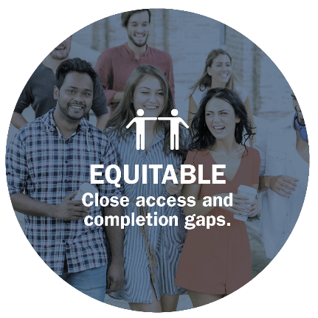
Goal 1: Equitable – Close Gaps
Supporting Strategies
Expand postsecondary opportunities and awareness to Virginians who may not view higher education as an option.
Advance digital access, adoption and literacy as well as high-quality, effective remote-learning programs.
Strengthen student support services for persistence and completion: mental health, mentoring, career services, social, student basic needs, information technology, disability support and other services.

Slide 17
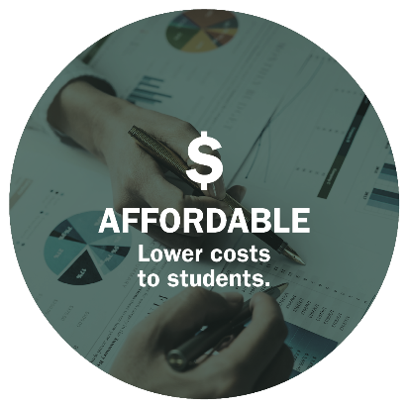
Goal 2: Affordable – Lower Costs
Supporting Strategies
Align tuition and fees, financial aid and state appropriations such that students have broader access to postsecondary education opportunities regardless of their ability to pay.
Cultivate affordable postsecondary education pathways for traditional, non-traditional and returning students.
Update and reform funding models and policies to improve equity, affirm return on investment and encourage increased and consistent levels of state funding.
Foster program and administrative innovations that enhance quality, promote collaboration and improve efficiency.

Slide 18
Goal 3: Transformative – Expand Prosperity
Supporting Strategies
Support experiences that improve students’ employment outcomes, income and community engagement.
Improve the alignment between post-secondary academic programs and labor market outcomes.
Cultivate a climate of inclusion and innovation through scholarship, research, a diverse faculty and other programming.

Slide 19
Measuring Success
Measures to Assess Goal Fulfillment
Goals | Measure
Goal 1 Equitable: Close access and completion gaps. | Attainment
 | Enrollment
Goal 2 Affordable: Lower costs to students. | Awards
 | Borrowing
Goal 3 Transformative: Expand prosperity. | Wages
Source: SCHEV and ACS data.
Notes:
Note: Other related indicators will be assessed along the way to mark progress and/or the need for changes in strategies/activities.

Slide 20
What are our Strengths and Challenges?
EQUITABLE ACCESS and COMPLETION
Strengths/Opportunities Graduation rates high at baccalaureate institutions Institution and community-based efforts to support access and completion Robust outreach to PK-12 Student transfer between community colleges and universities | Challenges/Threats Lower enrollment and completion by Hispanic, African-American, low-income and male students Lower graduation rates at community colleges Lack of awareness of the value of higher education and of postsecondary opportunities among too many middle- and high-school students

Slide 21
What are our Strengths and Challenges?
AFFORDABILITY and EXCELLENCE
Strengths/Opportunities Low average net price (discount after aid) at several institutions Higher average student financial aid compared to other states Leveling off of student debt Lower tuition and fee increases in recent years | Challenges/Threats “Sticker shock” of college costs Higher tuition and fees/lower state support for operations Variability in state support Faculty salaries low compared to peer institutions (34th percentile)

Slide 22
What are our Strengths and Challenges?
TRANSFORMATION and PROSPERITY
Strengths/Opportunities $1 billion to meet tech talent initiative Increased graduates in STEM-H related fields Alignment of degree programs to workforce/skills needs Funding and implementation of statewide internship program and non-degree credentials | Challenges/Threats Shortages in many employment sectors, such as health care, teaching, computer science and skilled trades Retention of graduates in Virginia Expected shortages in sub-baccalaureate credentials (associate degrees, certificates and industry certifications) Potential economic downturn

Slide 23
Considerations of Public-institution Boards
What are the roles of our public institutions in:
Providing affordable and equitable access to all?
Improving student success for work and life?
Driving change and improvement in education?
Expanding prosperity and transforming the social, cultural and economic well-being of individuals, communities, regions and the Commonwealth?

