Slide 1

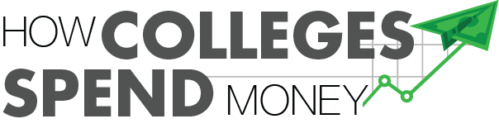
Analysis and Benchmarking of Institutional Spending
2022 Virginia Boards of Visitors Orientation
Armand Alacbay, Chief of Staff & Senior Vice President of Strategy
American Council of Trustees & Alumni (ACTA)
AAlacbay@GoACTA.org | www.GoACTA.org

Slide 2

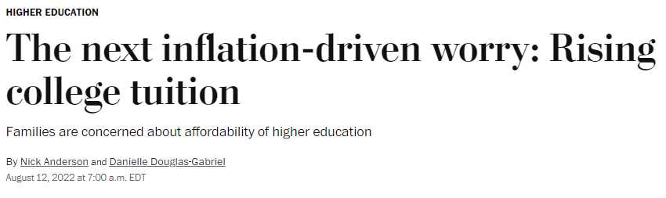

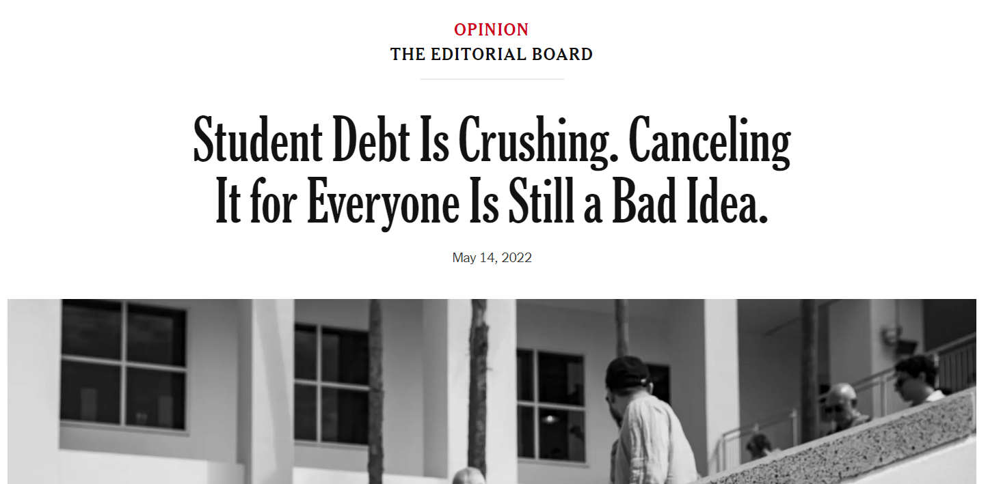

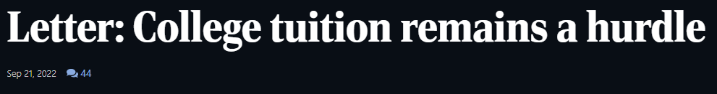

Slide 3
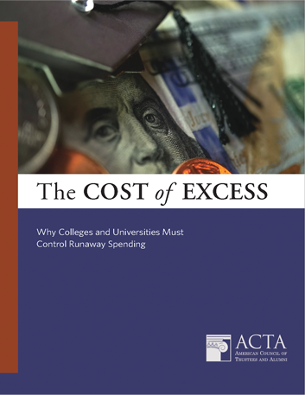

The Cost of Excess
Analysis of data from over 1,500 institutions.
Spending correlated with higher tuition, even after controlling for levels of appropriations.
Non-instructional spending growing faster than instructional spending.
Spending increases only minimally correlated with increasing graduation rates.
Download at GoACTA.org/Resource/Cost-of-Excess

Slide 4
The Cost of Excess: Takeaways
The student debt crisis is fundamentally a spending crisis.
Institutions need to prioritize access instead of excess by scrutinizing non-essential spending and performing long-overdue cuts with an eye on lowering the overall cost of a college education.

Slide 5
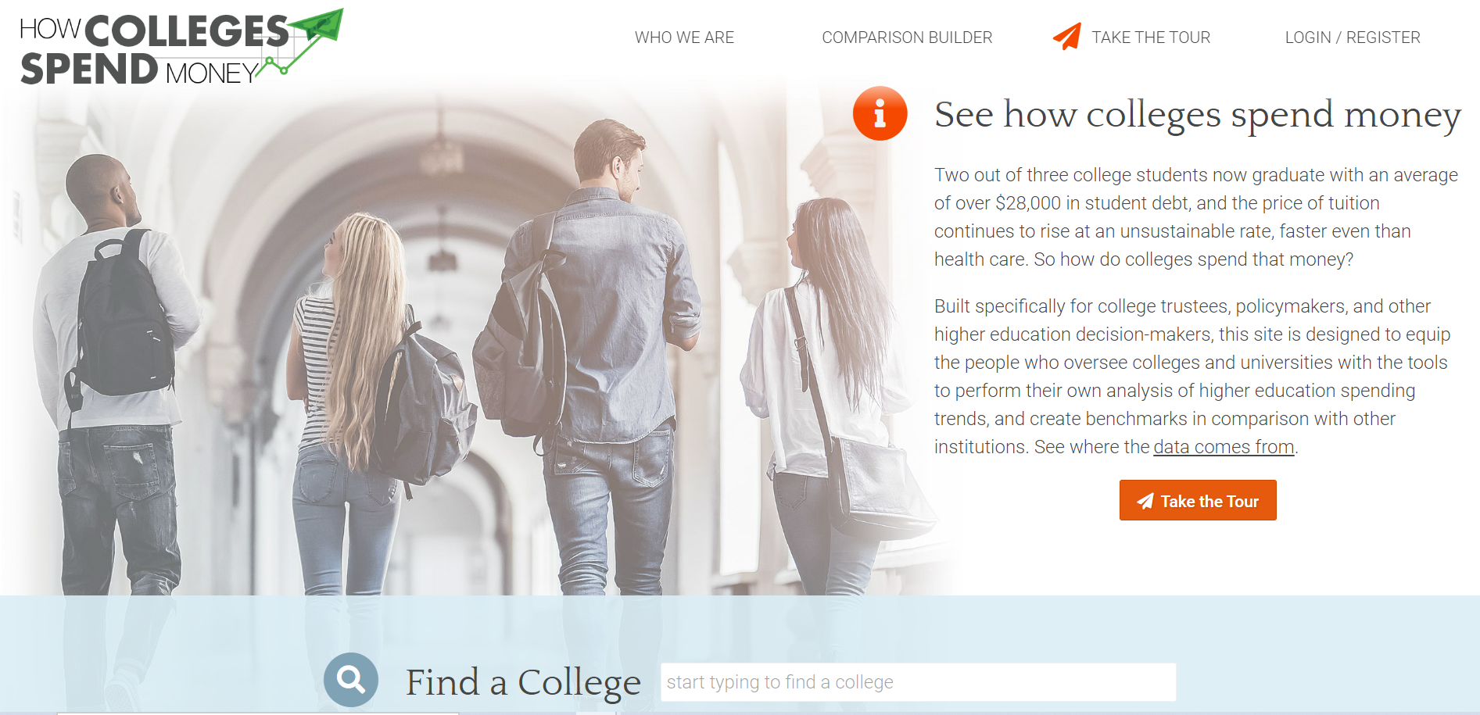
HowCollegesSpendMoney.com
Free for the public, designed for trustees
Data from over 1,500 four-year public and private colleges
Nine years of data
Spending, tuition, enrollment and other information

Slide 6
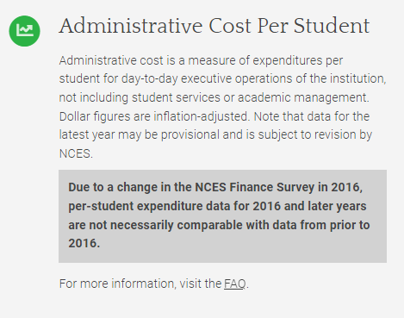
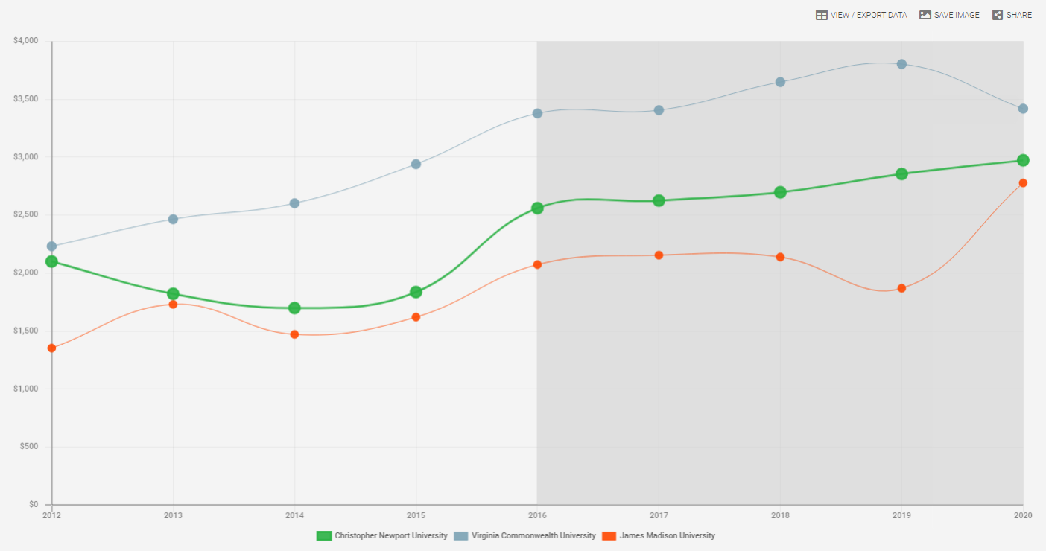

Slide 7
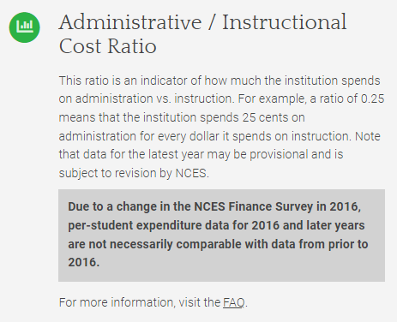
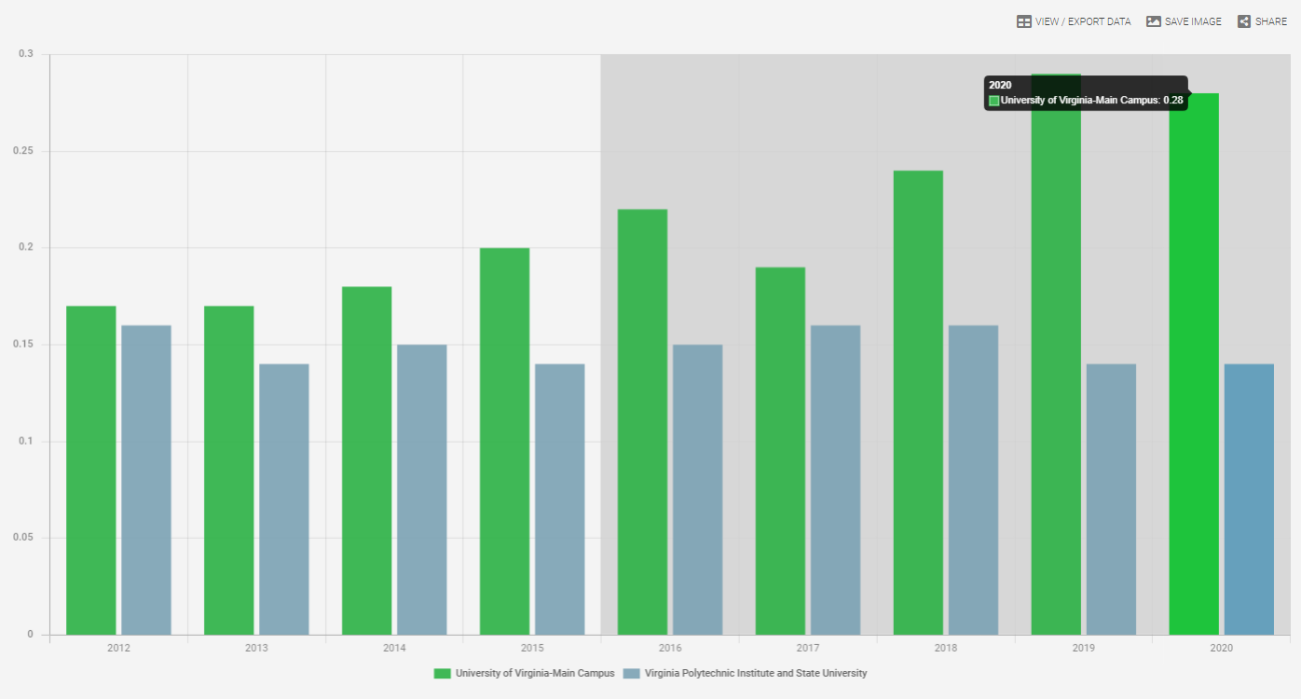

Slide 8
HowCollegesSpendMoney.com
Instructional spending per student
Administrative spending per student
Student services spending per student
Administrative/instructional cost ratio
Trends in in-state tuition (inflation-adjusted)
Tuition as a % of state median household income
4-year graduation rates

Slide 9

“Recommended Peer Group” Function
-State flagship
-Peers self-chosen by the institution include:
Duke
Johns Hopkins
Univ. of Pennsylvania
USC

Slide 10
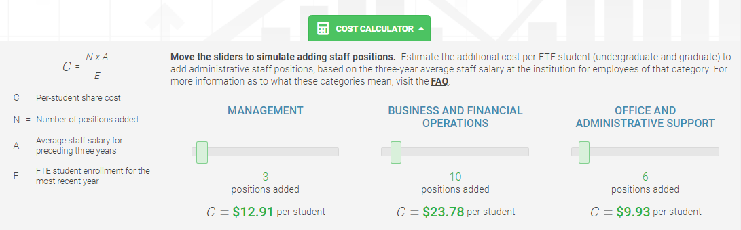
Cost Calculator Tool

Slide 11
Questions?
Armand Alacbay, Chief of Staff & SVP of Strategy, ACTA
AAlacbay@GoACTA.org | 202-467-6787
GoACTA.org | HowCollegesSpendMoney.com

