Slide 1
2022 BOARDS OF VISITORS ORIENTATION
Boards’ Roles in Freedom of Speech/Expression, Academic Freedom and Intellectual Diversity
Michael B. Poliakoff, Ph.D.
The American Council of Trustees and Alumni (ACTA)

Slide 2
Statutory responsibilities for free expression
VA Code Ann. 23.1-401.1. Constitutionally protected speech; policies, materials, and reports; report.
“[B.] Each public institution of higher education shall establish and include in its student handbook, on its website, and in its student orientation programs policies regarding speech that is constitutionally protected under the First Amendment to the United States Constitution and the process to report incidents of disruption of such constitutionally protected speech [...]"
“[C.] Each public institution of higher education shall develop materials on the policies established pursuant to subsection B and notify any employee who is responsible for the discipline or education of enrolled students of such materials.
Amendment 9:
requires annual reports of, "an official commitment and set of policies and practices to support freedom of expression and inquiry, free speech, academic freedom, and diversity of thought" and "an annual report on freedom of expression and inquiry, free speech, academic freedom, and diversity of thought to the Secretary of Education, including related incidents and statistics from the prior academic year."

Slide 3
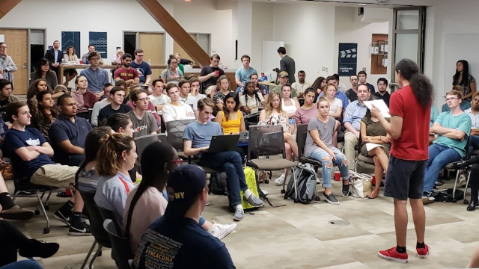
Positive signs at VA Public Institutions
Statutory requirement to communicate and protect First Amendment protected speech (VA Code Ann. § 23.1-401.1)
University of Virginia, College of William and Mary, and George Mason University are FIRE green light schools (Virginia Tech is Yellow Light).
Photo credit: Braver Angels

Slide 4
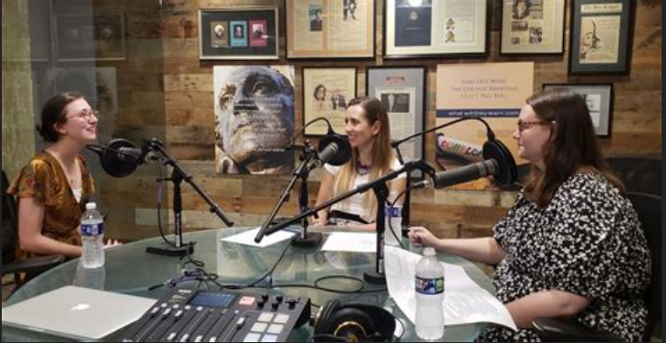
Room for Improvement
“I went to college to learn from my professors and peers. I welcomed an environment that champions intellectual diversity and rigorous disagreement. Instead, my college experience has been defined by strict ideological conformity. Students of all political persuasions hold back — in class discussions, in friendly conversations, on social media — from saying what we really think.” Emma Camp, UVA ‘22, NYT

Slide 5
Room for Improvement
FIRE 2022 Free Speech Rankings Survey: half of UVA students say there is at least some pressure to avoid controversial class topics.
54% of George Mason students, 62% of Virginia Tech students, and 48% of William & Mary students say the same.
About half (49%) of UVA students also say that at least occasionally, they feel they can’t express themselves because of how others in the community would react.
47% of George Mason students agree. So do 52% of Virginia Tech students and 59% of William & Mary students.
53% of UVA students feel "somewhat" or "very" uncomfortable publicly disagreeing with a professor.
58% of George Mason students agree. So do 68% of Virginia Tech students and 50% of William & Mary students.
37% of UVA students say that it is "extremely" or "very" clear that their administration protects free speech on campus.
38% of George Mason students agree. So do 20% of Virginia Tech students and 28% of William & Mary students.

Slide 6
The ACTA Gold Standard for Freedom of Expression
Commit to a Culture of Free Expression
Foster Civil Discourse
Cultivate Intellectual Diversity
Break Down Barriers to Free Expression
Advance Leadership

Slide 7
Commit to a Culture of Free Expression
Adopt
Adopt the Chicago Principles on Freedom of Expression or a similarly strong statement.
Establish
Establish clear expectations regarding free expression in student, faculty, and staff handbooks and codes of conduct.
Include
Include a free expression unit in new-student orientations.
Protect
Protect the diversity of political viewpoints by adopting an institutional neutrality policy such as the Kalven Committee Report.

Slide 8
Foster Civil Discourse
Sponsor campus debates that model civil discourse.
01
Encourage establishment of student groups promoting free expression.
02
Protect the rights of invited speakers and listeners to engage with controversial ideas.
03
Establish and enforce consequences that deter disruption of sponsored speakers, events, and classes.
04

Slide 9
Cultivate Intellectual Diversity
Encourage presidents, provosts, and deans to model respect for a broad range of viewpoints.
1
Guarantee that viewpoint diversity is reflected in student life policies and practices.
2
Support academic centers dedicated to free inquiry and intellectual diversity.
3
Make intellectual diversity a stated goal in faculty hiring, evaluation, and promotion.
4

Slide 10
Break Down Barriers to Free Expression
Eliminate speech and IT policies that have a chilling effect on free expression.
1
Ensure that Title IX and other disciplinary procedures do not infringe on free expression.
2
Disband bias response teams.
3
Review student government policies to ensure viewpoint neutrality in student group recognition and funding.
4

Slide 11
Advance Leadership
Include
Include a commitment to free expression as a criterion for presidential searches and evaluations.
Incorporate
Incorporate explicit policies of free expression in governance bylaws and other key institutional documents.
Require
Require free expression and viewpoint diversity training for administrative staff.
Conduct
Conduct regular evaluations of the state of free expression and intellectual diversity on campus.

Slide 12
For More Information, Please Reach Out To:
ACTA President Michael Poliakoff @ mpoliakoff@GoACTA.org
ACTA Paul & Karen Levy Fellow in Campus Freedom Steven McGuire @ smcguire@GoACTA.org
ACTA Chief of Staff & Senior VP of Strategy Armand B. Alacbay @ aalacbay@GoACTA.org
www.GoACTA.org or (202) 467-6787

