Slide 1
Best Practices for Effective Governance: Advice from Rectors and Presidents
AKA:
NEW BOV MEMBER MADNESS
Moderator: Judi Lynch, Member and Former Vice Rector: Longwood University

Slide 2
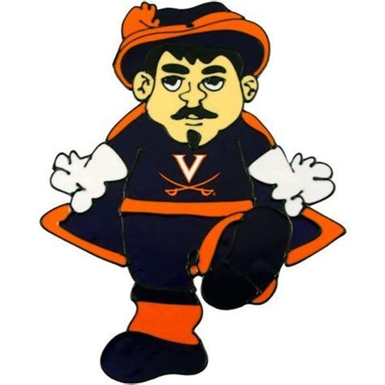
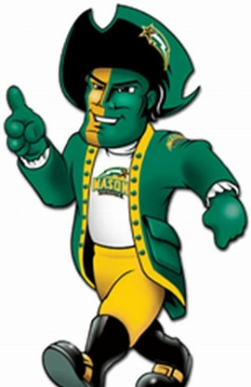
MAKOLA ABDULLAH
President / Virginia State University
TAYLOR REVELEY IV
President / Longwood University
WHITT CLEMENT
Rector / University of Virginia
JIMMY HAZEL
Member * Former Rector / George Mason University
FINAL FOUR

Slide 3
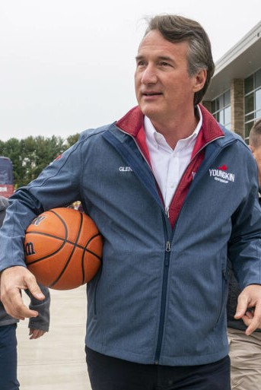
HEAD COACH: GOVERNOR GLENN YOUNGKIN
OFFENSIVE COACHES: PRESIDENTS; RECTORS [BOVs]
DEFENSIVE COACHES: PRESIDENTS; RECTORS [BOVs]
TRAINERS: FACULTY AND STAFF
PLAYERS: STUDENTS
FANS: CITIZENS
REFEREE: SECRETARY OF EDUCATION AIMEE GUIDERA

Slide 4
2-POINT SHOTS

Slide 5
3-POINT SHOTS

Slide 6
FOUL SHOTS

Slide 7
FULL ~ COURT PRESS ** MEDIA **

Slide 8
DOUBLE DRIBBLE
RECTORS / BOV REPRESENT AND ARE RESPONSIBLE TO THE GOVERNOR
RECTORS / BOV REPRESENT AND ARE RESPONSIBLE TO THE UNIVERSITY

Slide 9
FREE THROW QUESTIONS ** anything goes **

Slide 10
GAME OVER ** Members terms expire **

Slide 11
OVERTIME ** Members are volunteers **

Slide 12
REMEMBER … *** It’s an incredible honor to represent Governor Youngkin Secretary Guidera Secretary James Higher Education THE COMMONWEALTH OF VIRGINIA & THE UNIVERSITIES on whose Boards of Visitors you were appointed to serve! ***
THANK YOU AND SAFE TRAVELS HOME!!

