Slide 1
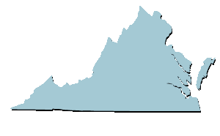
Virginia’s Budget
Virginia Department of Planning and Budget (DPB)

Slide 2
2022-2024 Budget: Nongeneral fund vs. General fund
The General Fund (36.7%)
From income and sales taxes paid by citizens and businesses
Can be used for a variety of government programs
Governor and General Assembly have the most discretion
Nongeneral Funds (63.3%)
Receipts set aside for specific purposes:
motor vehicle and gas taxes for transportation programs
student tuition and fees for higher education
federal grants for specific activities

Slide 3
Where the operating money goes- General Fund 2022-2024

Slide 4
Budgetary authorization for higher education involves several major programs
Educational and General (E&G)
General fund (GF) and nongeneral fund (NGF) sources (tuition and fee revenue)
Student Financial Assistance
General fund and nongeneral fund (federal assistance and tuition revenue)
Sponsored Programs (Research)
General fund and nongeneral fund (federal and private grants)
Institution specific initiatives
Auxiliary Enterprises
Nongeneral fund only (self-supporting activities such as residential facilities, dining halls, and parking)

Slide 5
Support for educational and general is a shared cost
Source: SCHEV

Slide 6
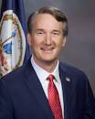
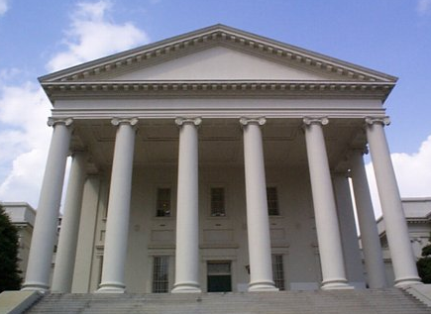
Many factors and perspectives influence budget development:
Priorities of the Governor
Priorities of the General Assembly
Public sentiment
Increases/ Decreases in federal funds
Changes in laws and regulations
Traditional practices
Increase in number of clients

Slide 7
Both E&G support and FTE students have grown
Notes: Data includes E&G appropriation for 17 institutions, VIMS and extension services.
FY 2010-11 includes SFSF appropriation.

Slide 8
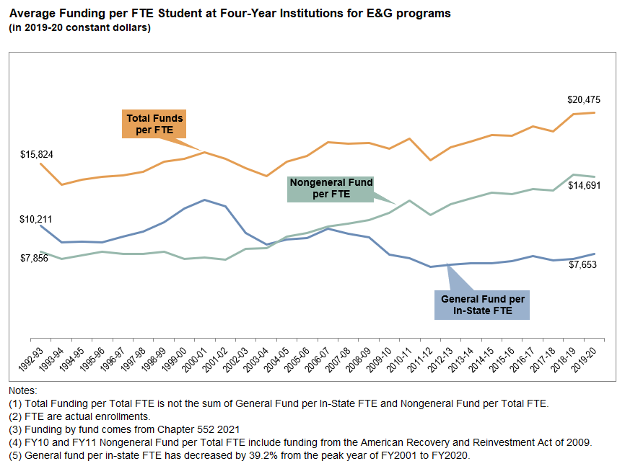
Average Funding per FTE Student at Four-Year Institutions for E&G programs has grown (from SCHEV 11/2020 Higher Education Funding report)
Total per FTE: 29% increase FY93-FY20, average annual increase 1.0%
NGF (tuition and fees)/FTE: 87% increase FY93-FY20, average annual increase 3.1%
GF per In-State FTE: 25% decrease FY93-FY20, average annual decrease 0.9%

Slide 9
Increases in tuition is one of the few state funding issues that historically has surpassed inflation (until recently)

Slide 10
As tuition has risen so has financial aid

Slide 11
What about the impact of the pandemic?!
Institutions incurred costs to implement distance education and telework and installing social distance infrastructure; continue to incur costs for procuring personal protection items, cleaning costs, and testing staff and students as needed.
Biggest impact was lost auxiliary revenues (room, board, parking, book store) with fewer students living on campus and dorms holding fewer students due to social distancing.
Although most institutions showed less loss of student enrollment than expected, tuition and fee revenues were generally down. Revenue from sporting events declined.
In the end, most of the fiscal implications were offset by federal funding to address the impacts of the pandemic.

Slide 12
A significant amount of the lost revenues and increased costs as a result of COVID have been offset by federal support

