Slide 1
Changing Demographics and Potential Impact on Enrollment
Presented to 2022 Boards of Visitors Orientation
October 19, 2022
Qian cai (pronounced “chien tsai”)
Director, Demographics Research Group
UVA Weldon Cooper Center for Public Service

Slide 2
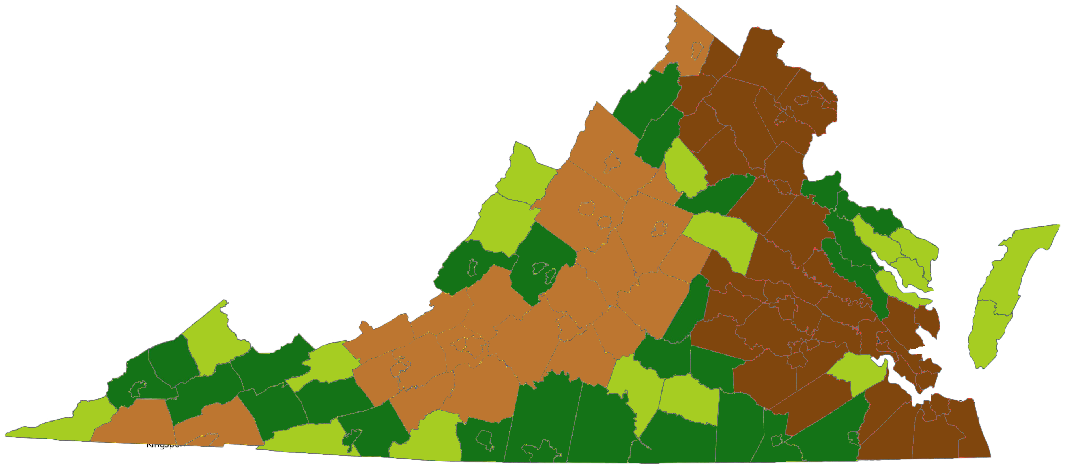
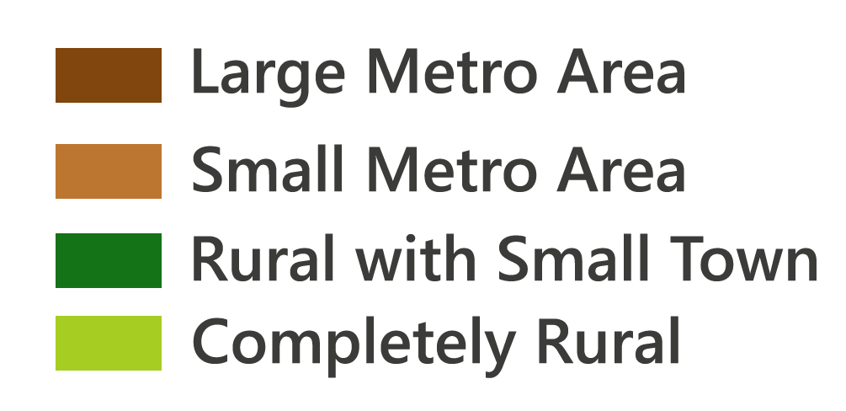
Urban/Rural Status

Slide 3
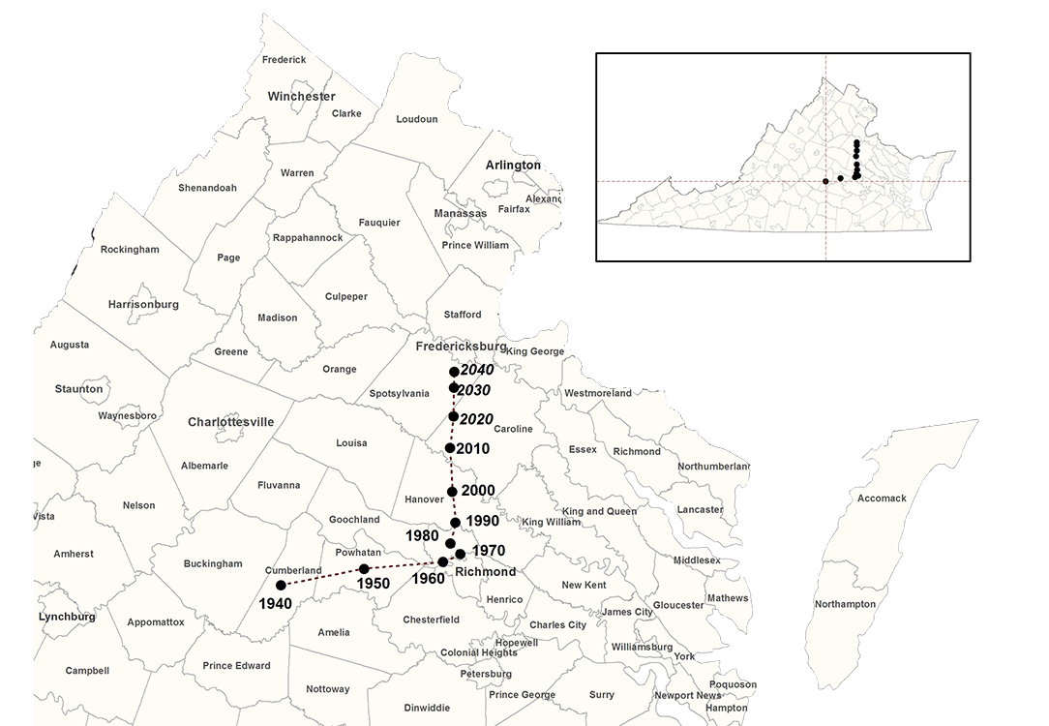
Virginia’s Changing Center of Population

Slide 4
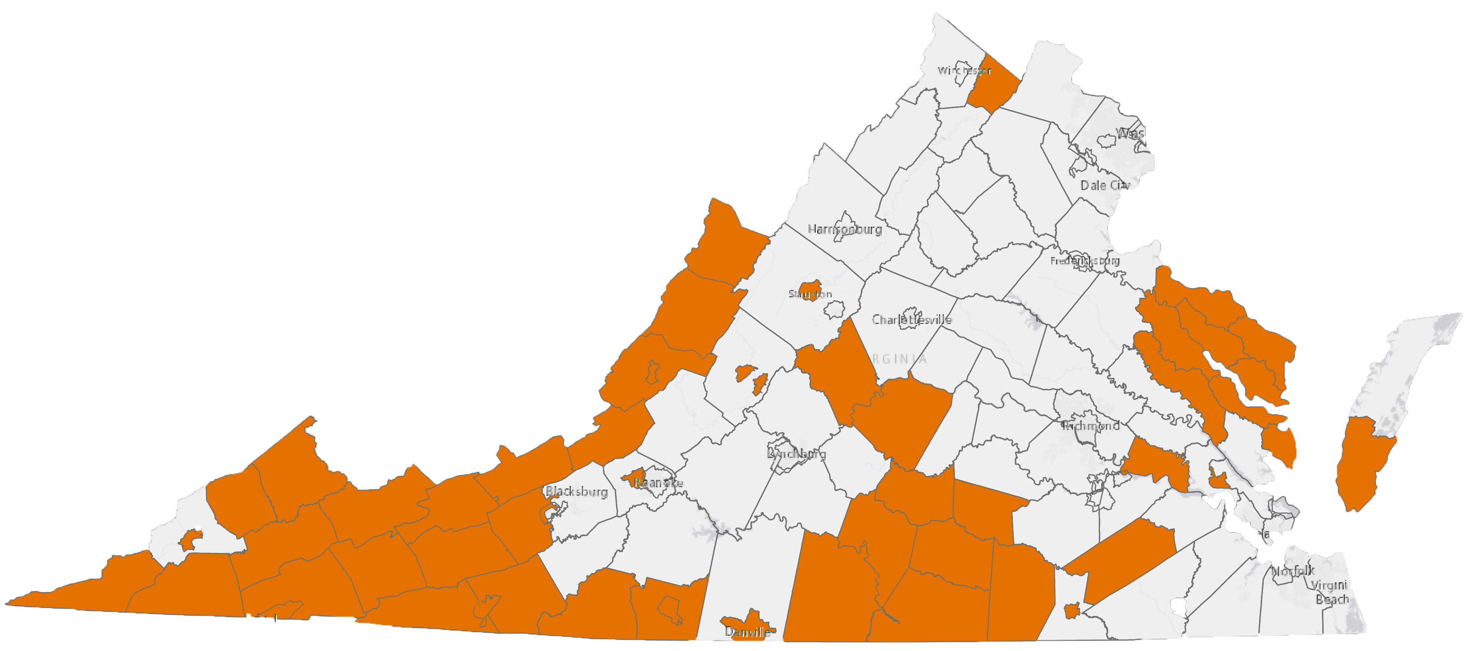
More deaths than births, 2000s

Slide 5
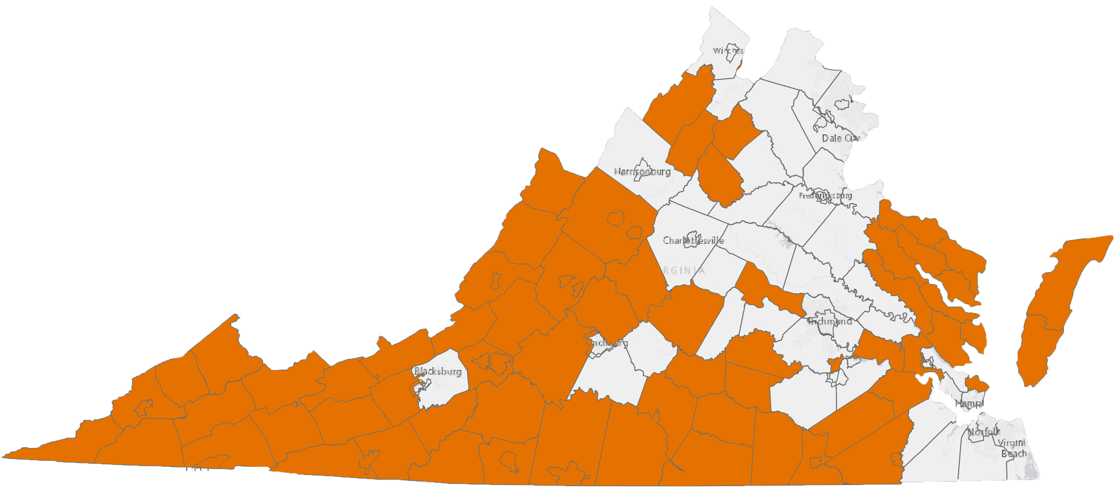
More deaths than births, 2010s

Slide 6
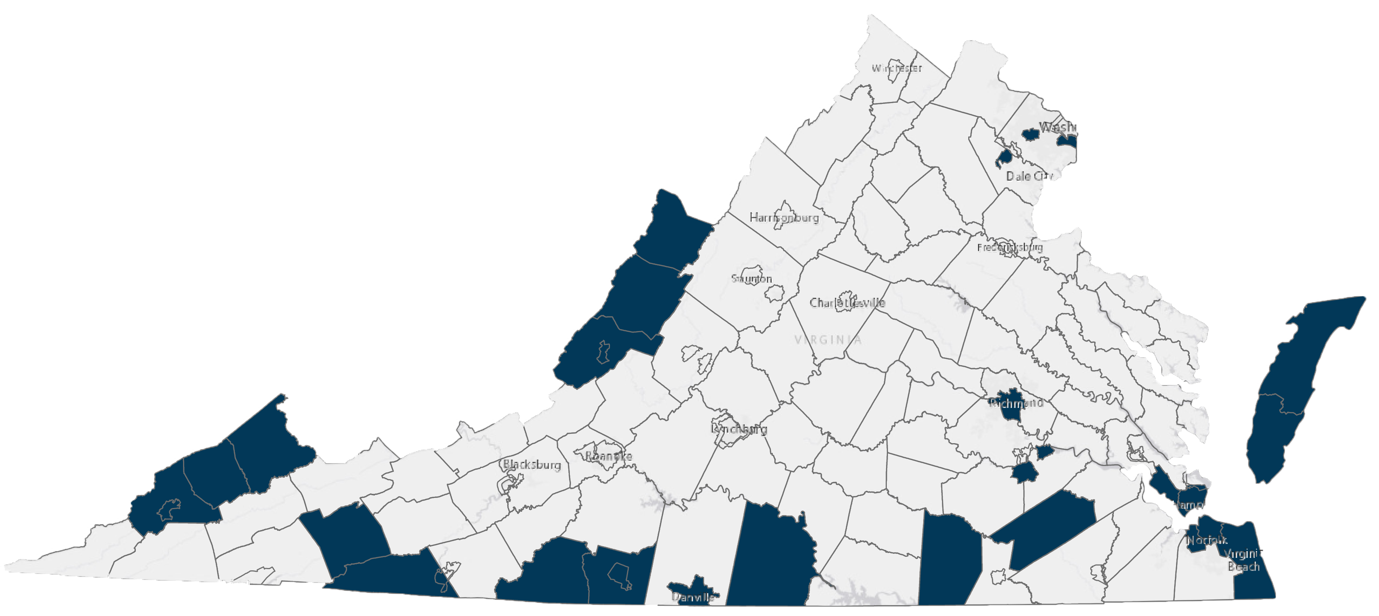
More people moving out than in, 2000s

Slide 7
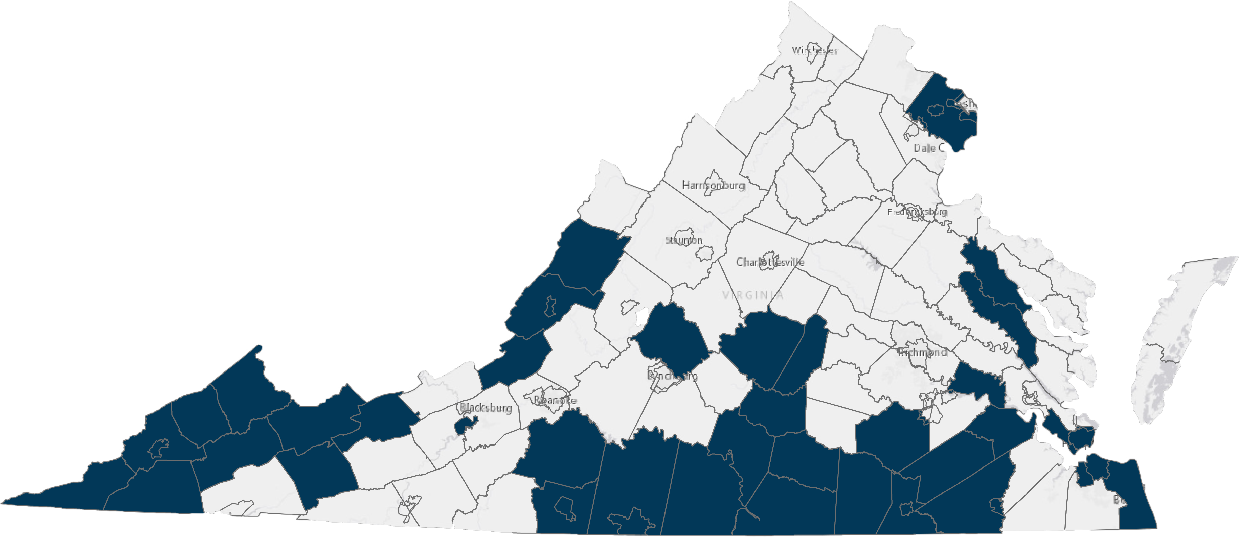
More people moving out than in, 2010s

Slide 8
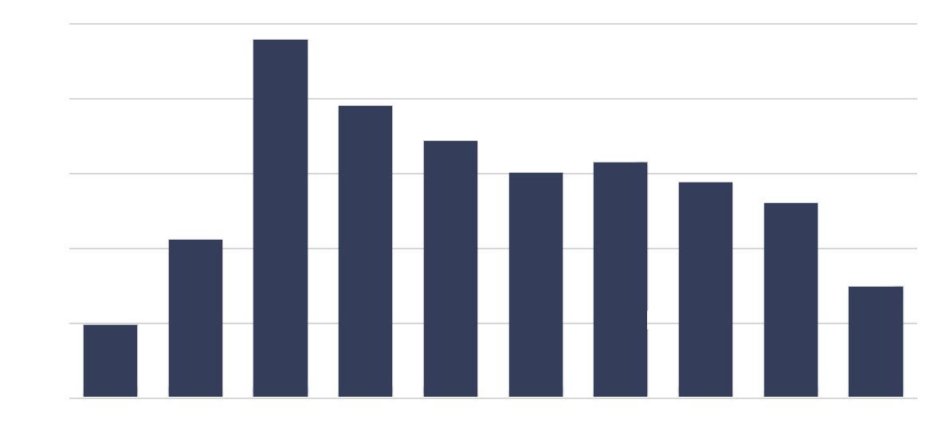
Virginia: Slowest Growth Rate since the 1930s
2.5%
Annual Population Growth
2.0%
1.5%
1.0%
0.5%
0.0%
1920s
1930s
1940s
1950s
1960s
1970s
1980s
1990s
2000s
2010s

Slide 9
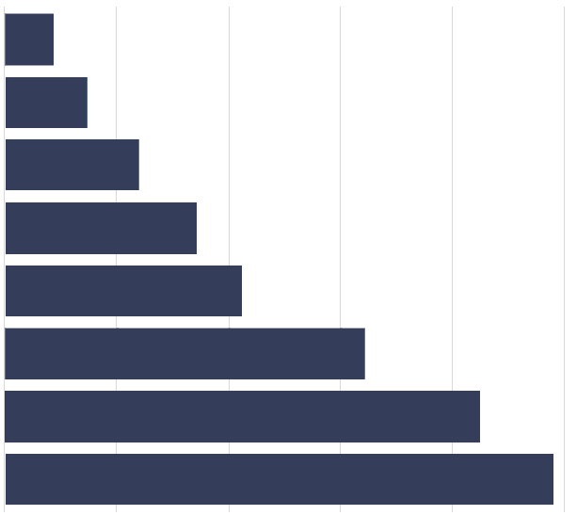
Virginia Population by Age in 1900
Over 70
60-70
50-60
40-50
30-40
20-30
10-20
Under 10
0
100,000
200,000
300,000
400,000
500,000

Slide 10
Virginia Population by Age in 2019
Over 70
60-70
50-60
40-50
30-40
20-30
10-20
Under 10
0
200,000
400,000
600,000
800,000
1 M
1.2 M

Slide 11
Virginia American Indian Population
Year |  | Number
1990 |  | 18,285
2000 |  | 62,437
2010 |  | 80,924
2020 |  | 180,239

Slide 12
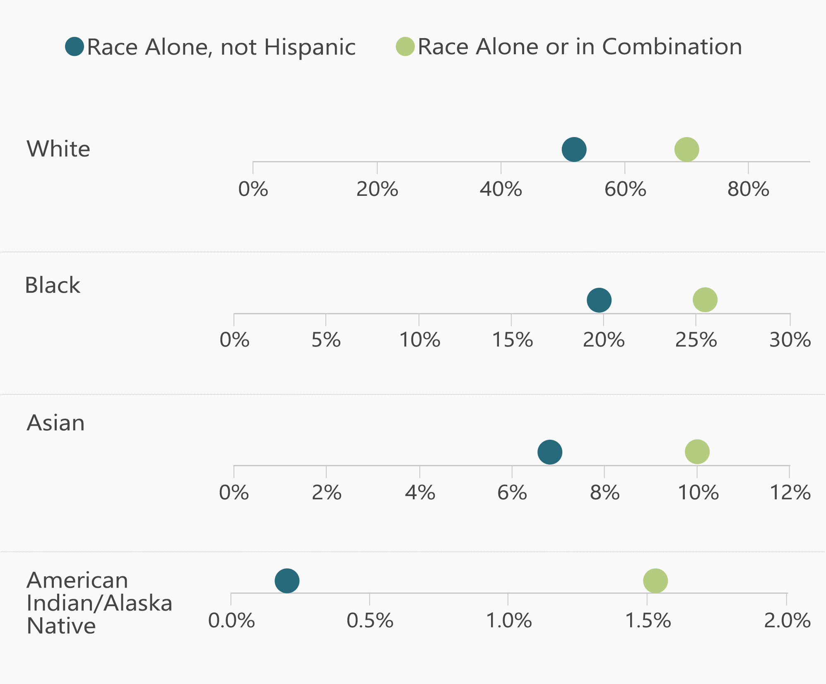
Population under 15 by Race, 2019

Slide 13
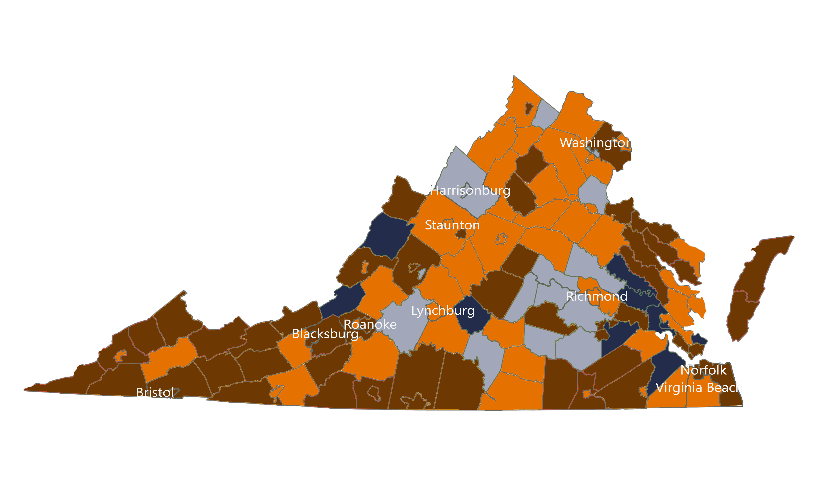
Change in Births, 2007 to 2021

Slide 14
Thank You
Qian cai (pronounced “chien tsai”)
Director, Demographics Research Group
UVA Weldon Cooper Center for Public Service
qian.cai@virginia.edu
https://demographics.coopercenter.org/

