Slide 1
Cardinal Education
SCHEV
May 16, 2023
Combining the Power of Six
leading state-funded universities,
Cardinal Education offers an online
engineering experience above the rest

Slide 2
There and Now… By the Numbers
36
Courses offered annually through Cardinal Education
6,000+
Average annual enrollment in graduate online Cardinal Education courses
Beginnings
Established in 1983
Commonwealth Graduate Engineering Program (CGEP)
Purpose
Deliver graduate engineering education to Virginia’s working engineers through state-of-the-art distributed learning technologies
Graduate online degrees and certificates offered through Cardinal Education
600+
Touch points to Cardinal Education member’s Six-Year Plans
37
“A pioneer in distance learning for 40 years.”

Slide 3
The Excellence and Reputation of Six Great Universities The quality of our program is backed by the standing of our nationally recognized member schools… And it’s the name of the university that appears on each of our graduates’ diploma.
Dr. Daniel Garrison
State Chair
Dr. Ram Gupta
Associate Dean
Dr. Amy Clobes
Assistant Dean
Dr. Alicia Johnson
Director
Dr. Anthony Dean
Associate Dean
Dr. Dawit Haile
Dean

Slide 4
Vision, Mission, & Outcome
Vision
Mission
Outcome
To be Virginia’s pre-eminent online provider of post-baccalaureate engineering education
By promoting and providing high quality workforce and professional development
To provide equitable, affordable, and transformative educational access for Virginia’s citizens and businesses
“Offering more ways to finish on time.”

Slide 5
Advancing Virginia’s Higher Education Outcomes
Transformative
Affordable
Increased flexibility
Faster time to degree completion
Equitable
Resource sharing and scaling
Leading course sharing and delivery model
Better industry-to-credential matching
Centralized student services
KSA access for all regions of Virginia
Outreach activities
Greater access to top faculty
“Convenience and flexibility,
Easy paths of entry,
Quality content.”

Slide 6
Forward-Thinking
Initiatives
Expanded Outreach
Digital and print media
Conference events
Targeted campaigns
Enhanced Partnerships
Industry associations
Engineering societies
Economic development
Best Practice Dissemination
Enrollment management
Systems and services
Resourcing and staffing
Cardinal Education Re-Launch
Virginia’s advanced STEM educational provider
Building out Centralized Services
Student support services
University support
Advancement and analysis
“Providing a wider range
of courses and
faculty.”

Slide 7
Industry Advisory Board Partners
“A resource to students
Employers, and the
Commonwealth.”

Slide 8
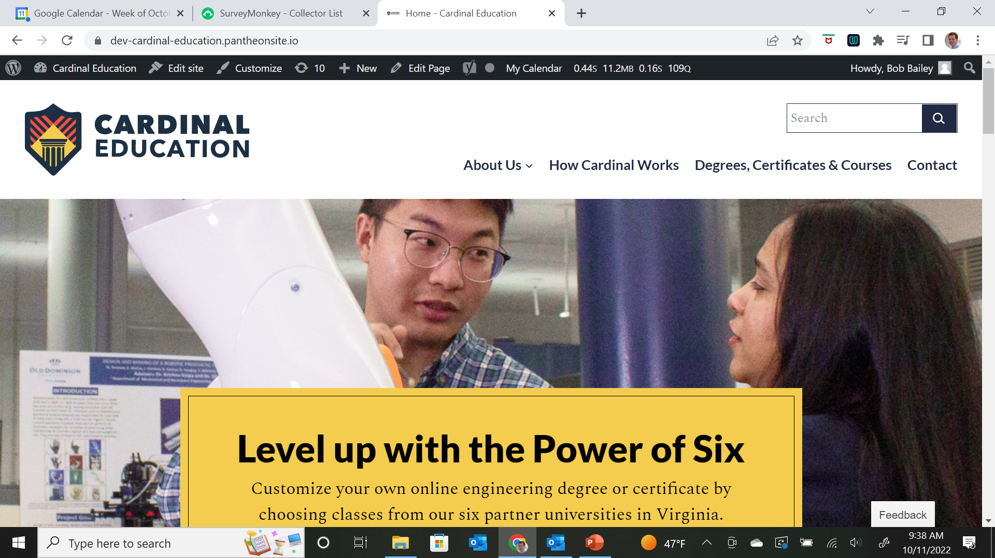
Equitable Affordable Transformative
Q&A
Discussion
Next Steps
cardinaleducation.org

