Slide 1
Designing More Intentional Civic EngagementThrough Assessment
The Civic Incomes Project at Radford University

Slide 2
The Issue
CE programming assumes all students are well-prepared
Varying levels of knowledge and skills at entry
Can lead to bad outcomes

Slide 3
The Question
“With what skill level does a student enter their undergraduate experience?”
How to better align engagement opportunities with students’ abilities?

Slide 4
The Goal
Identify students' skills levels at beginning of college career
Empowers educators to
Create more intentional CE programming
Inform curricular development
Show growth

Slide 5
The Plan
Students take the assessment at UNIV 101
Follow-up survey
End of sophomore year
At graduation
Can be adapted to other skills and knowledge
Written communication
Critical thinking
Math skills

Slide 6
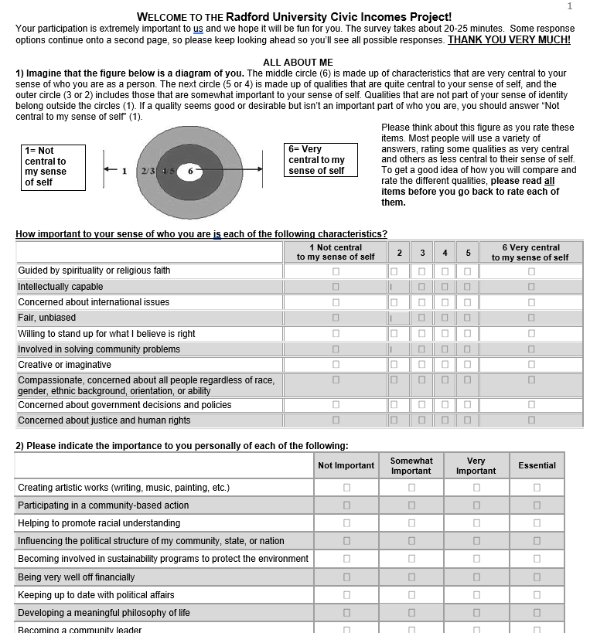
The Instrument
Total of 22 questions
Measures orientations, skills, and values
Personal goals
Views of citizen involvement
Political efficacy
News consumption and media literacy
Duties of a citizen
Political socialization

Slide 7
Questions?
Chapman Rackaway
Professor and Chair, Department of Political Science
Radford University
Voice: 540-831-6602
Email: crackaway@Radford.edu
Portfolio: www.chapmanrackaway.com

