Slide 1








Cardinal Education
SCHEV
2023 Annual Report
Combining the Power of Six
leading state-funded universities,
Cardinal Education offers an online
engineering experience above the rest

Slide 2





The Excellence and Reputation of Six Great Universities
The quality of our program is backed by the standing of our nationally recognized member schools…
And it’s the name of the university that appears on each of our graduates’ diploma.
Dr. Gary Tepper
State Chair & Senior Associate Dean
Dr. Daniel Garrison
Director & Associate Chair
Dr. Alicia Johnson
Director
Dr. Stacie Ringleb
Associate Dean
Dr. Dawit Haile
Dean
Dr. Amy Clobes
Assistant Dean

Slide 3

Vision, Mission, & Outcome
Vision
Mission
Outcome
To be Virginia’s pre-eminent online provider of post-baccalaureate engineering education
Promote and provide high quality workforce and professional development
Equitable, affordable, and transformative educational access for Virginia’s citizens and businesses
“Offering more ways to finish on time.”

Slide 4


Leadership and Innovation – 1983 to Now
Innovation & Leadership
1983-1984
Broadcasted classes from university to university
1986 – 1990
Expanded to receive sites across the state
1994 – 2006
Adopted new broadcast technologies
2011
Implemented online delivery platform
2012 – 2014
Offered synchronous and asynchronous delivery modes
2014 – 2018
Expanded courses, degrees offerings and partners
2019 – now
Centralized services, marketing, new credentials
Expansion
Transition
Leadership
(Platform)
Innovation (Technology)
Adaptation
Growth
Notes:
Emphasize the long history of collaboration among CGEP universities
Emphasize the adjustments made to meet needs over the history
Emphasize leadership in collaboration, new technologies, adapting

Slide 5
How Cardinal Works
Overview
Cardinal Education is a consortium of six Virginia public universities that offers online master’s in engineering degrees.
Students can take classes while employed, and can mix and match courses from all six universities. This provides more flexibility and decreases the time to completion due a broader range of courses to pick from.
Interested students need to determine
Are they seeking a credential, or just a course or two?
If a credential, determine which school will be your “home” institution? (based on the credential)
Full-time or part-time?
Can your employer help?
1. Credential or course?
2. Apply to the “home” school and program.
3. Develop a plan of study.
core courses required for the selected degree
Explore course options across all the schools with our Course Finder.
allowable electives.
Course sharing.
Register for your courses.

Slide 6
Features and Benefits
Features | Benefits
State of the Art On-line Delivery Technology | Flexibility – take courses on your own schedule Take courses while continuing in your job Differentiates Virginia – a recruiting resource for VEDP
Course Sharing – students can take up to 49% of their credits from on of six Virginia universities | Shortens time to degree completion Allows greater course selection
Public-Private Partnership with Industry – a strong and engaged industry advisory board | Insures the relevance of the courses and degrees Contributes to the economic development and social well-being of Virginia through workforce training and life-long learning.
World Class Universities – Cardinal Education universities are all highly ranked institutions with strong reputations | Earn a degree from a top ranked institution
World Class Faculty | Access to expertise, research and a community of academic leaders

Slide 7
Value Proposition
Students
Stay in your job
Industry
Recruit new employees
Commonwealth of Virginia
Differentiates Virginia
Shorten time to degree
Available wherever the student works
Respond to industry needs
Strengthens workforce
Resource for VEDP
35 years of innovation

Slide 8
What Does a Cardinal Education Student Look Like?

Slide 9
A Cardinal Education student has a median age of 30 and has, on average, 4-6 years work experience

Slide 10
Outreach Activities for 2023
18
Specific outreach events and activities to engineering communities to date this year
4,180
Number of individuals in Virginia's engineering community engaged by activities to date this year
7,198
Number of individuals specifically targeted by above activities
284
Number of contacts in CRM database

Slide 11
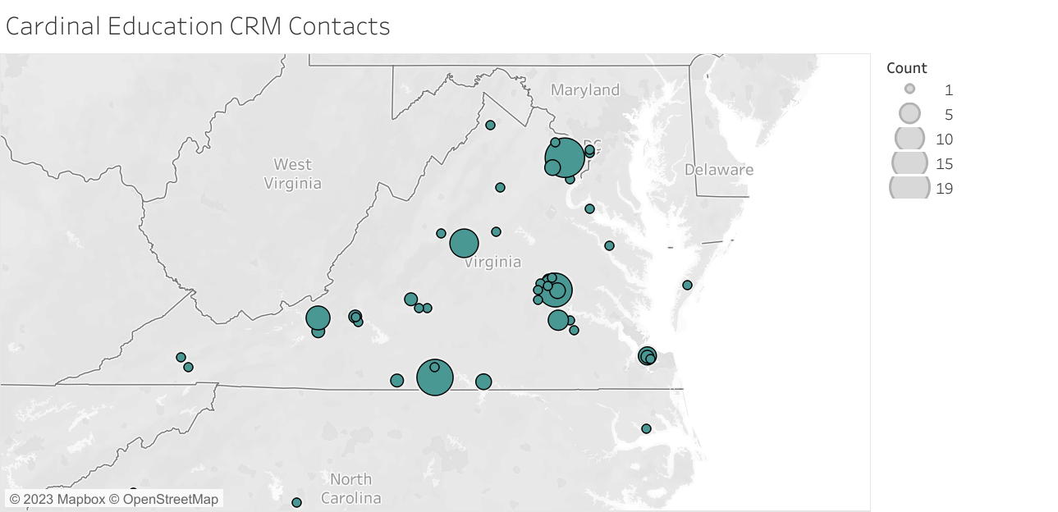
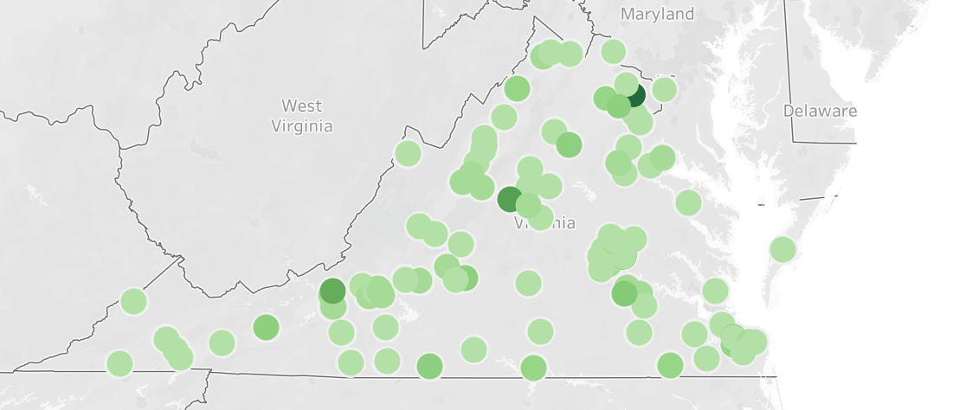
Growth in Geographic Regions Reached – CRM
2022 Contacts
2023 Contacts

Slide 12
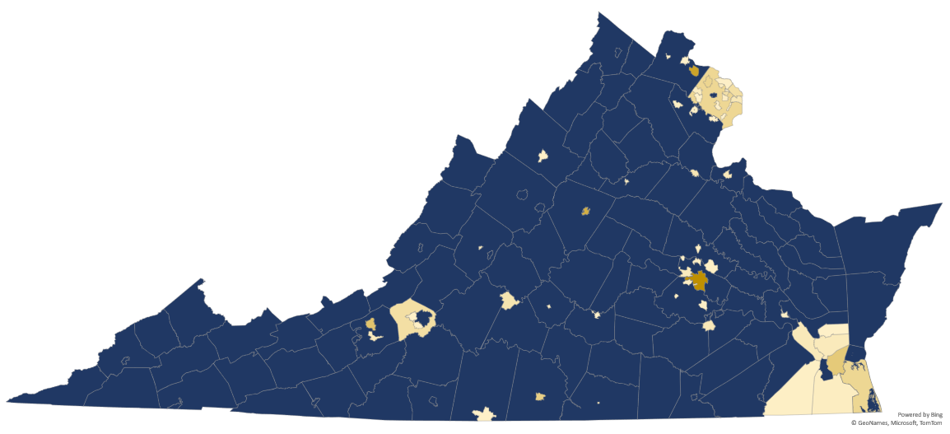
Geographic Regions Reached – Website Visits

Slide 13
Enrollments - The 6 universities in Cardinal Education enroll between 600-700 online graduate engineering students in the previous 2 academic years, increasing to 900 this past year

Slide 14
Growth of Online Graduate Courses Available

Slide 15
Features of Online Courses
 | Accessibility | Support Services | Technical Support Available | Vehicles of Instruction
All | Identical content to face-to-face classes | Live technical support Resume help Mentoring Financial aid services Registration and admissions counseling Academic advising Access to live librarian | Weekdays | Bulletin boards Software based readers Recorded video Live streaming video
Most | Large number of classes in the evening Large number of classes synchronous | Writing workshops Local area network Live tutoring Bookstore | Weekday evenings Weekend days Weekend evenings | Applications for display on smartphone or tablet Simulations Recorded and live streaming audio
Many | Over half of all classes synchronous | 24/7 technical support | Weekday overnight Weekend overnight | Learning analytics platform Adaptive learning Online labs

Slide 16
Industry Support

Slide 17
Program Partners

Slide 18
Graduates
100+ and Growing
Total number of graduates each year
49%
Overall graduation rate
2.6 Years
Most frequent duration of time from matriculation to graduation
Note: not all students are seeking a degree.
Increase to 180 this past year

Slide 19
Impacts on Wage and Employment
74%
Reported receiving a raise or promotion within 6 months of completing their credential
83%
employed within 6 months of completing their degree

Slide 20
Allocation of Resources
General Assembly Support
Faculty professional development & course development
Technology Infrastructure
Centralized Services to SVHEC (former receive site support)
University Support Staff

Slide 21
Advancing Virginia’s
Higher Education Outcomes
Transformative
Affordable
Increased flexibility
Faster time to degree completion
Equitable
Resource sharing and scaling
Leading course sharing and delivery model
Better industry-to-credential matching
Centralized student services
KSA access for all regions of Virginia
Outreach activities
Greater access to top faculty
“Convenience and flexibility,
Easy paths of entry,
Quality content.”

Slide 22
Data Sources
USNews Survey data from member universities
Google Analytics on website
LinkedIn analytics
CRM analytics

