Slide 1
Overview of
Virginia Higher Education
Boards of Visitors Orientation
November 12, 2024
Scott Fleming, SCHEV Director
Alan Edwards, SCHEV Strategic Planning & Policy Studies Director
Lee Andes, SCHEV Finance Policy & Innovation Interim Director

Slide 2
Virginia Higher Education Landscape
15
30
PRIVATE NONPROFIT COLLEGES AND UNIVERSITIES
PUBLIC FOUR-YEAR INSTITUTIONS
24
300+
PUBLIC TWO-YEAR INSTITUTIONS
(23 COMMUNITY COLLEGES + 1 TRANSFER COLLEGE)
FOR-PROFIT, OUT-OF-STATE OR VOCATIONAL INSTITUTIONS
5
HIGHER EDUCATION CENTERS

Slide 3
Virginia Higher Education Landscape
132,287
70.9%
DEGREES & CERTIFICATES AWARDED IN 2023-24
PUBLIC FOUR-YEAR GRADUATION RATE (2nd IN NATION)
542,702
$61,502
ENROLLED FALL 2023
MEDIAN WAGES, 5 YEARS AFTER BACHELOR’S DEGREE
$15 billion
$26,000
ANNUAL HIGHER EDUCATION EXPENDITURES
MEDIAN DEBT UPON GRADUATION FOR BACHELOR’S DEGREE

Slide 4
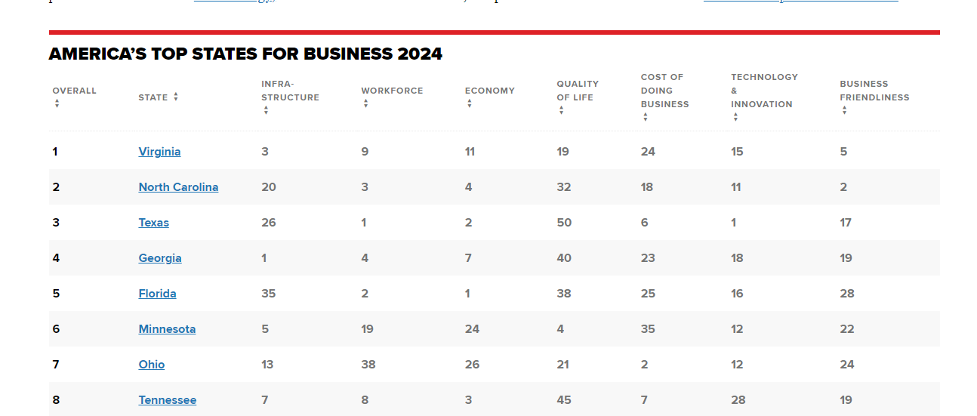
Number One for Business . . .

Slide 5
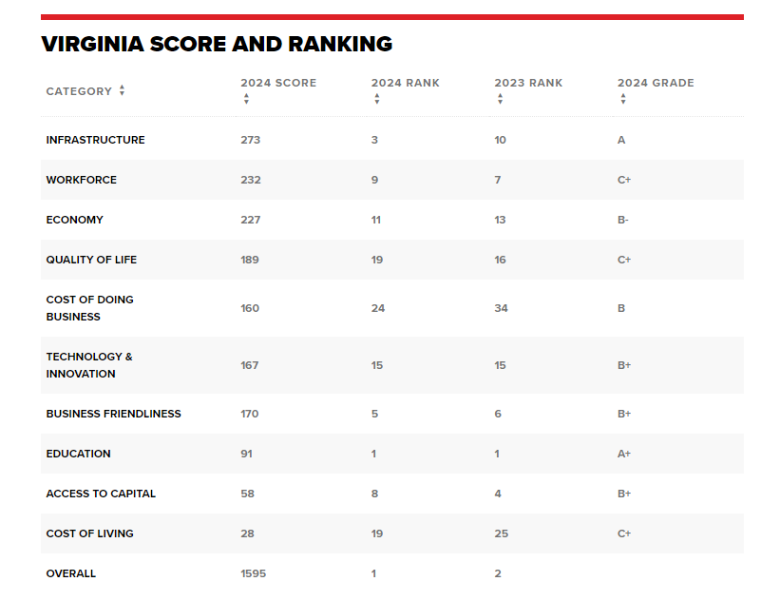
. . . and Education
For two years running, Virginia is number one for education

Slide 6
State Return on Investment
“Every dollar spent on public higher education by the state is associated with an additional $1.89 in state revenue and an increment of $25.59 to Virginia’s gross domestic product.”
“Economic Impact Study of Virginia Public Higher Education”
Weldon Cooper Center for Public Service
July 1, 2023

Slide 7
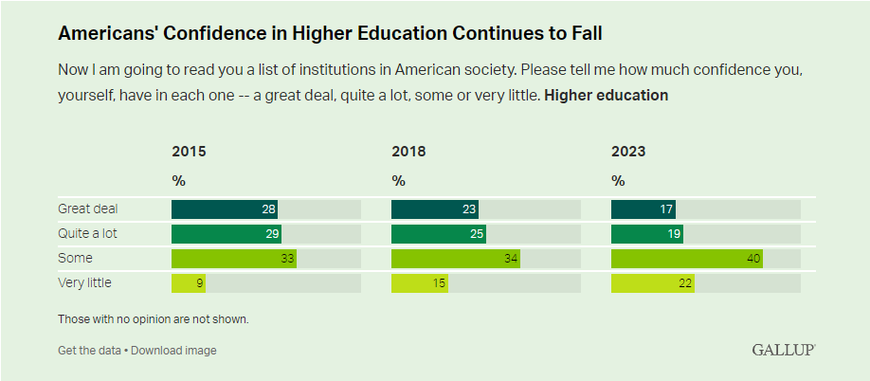
Declining Confidence in Higher Education

Slide 8
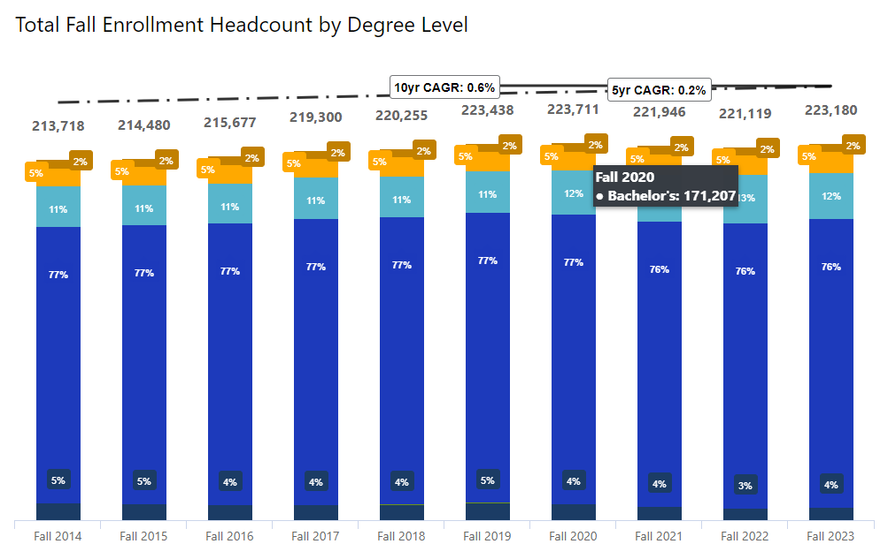
Virginia’s 4-Year Enrollment is Flat
2023 enrollment is roughly equal to 2019 enrollment
2023 enrollment is only 10,000 students more than 2014

Slide 9
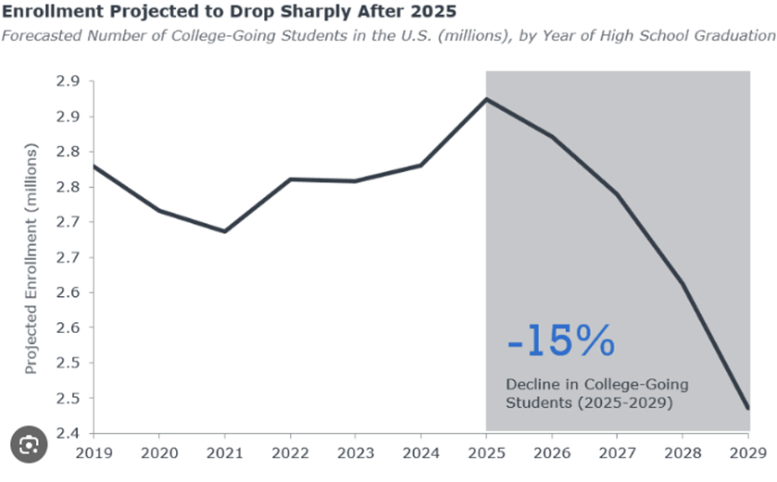
National Enrollment Declining
Source: Lumina Foundation

Slide 10
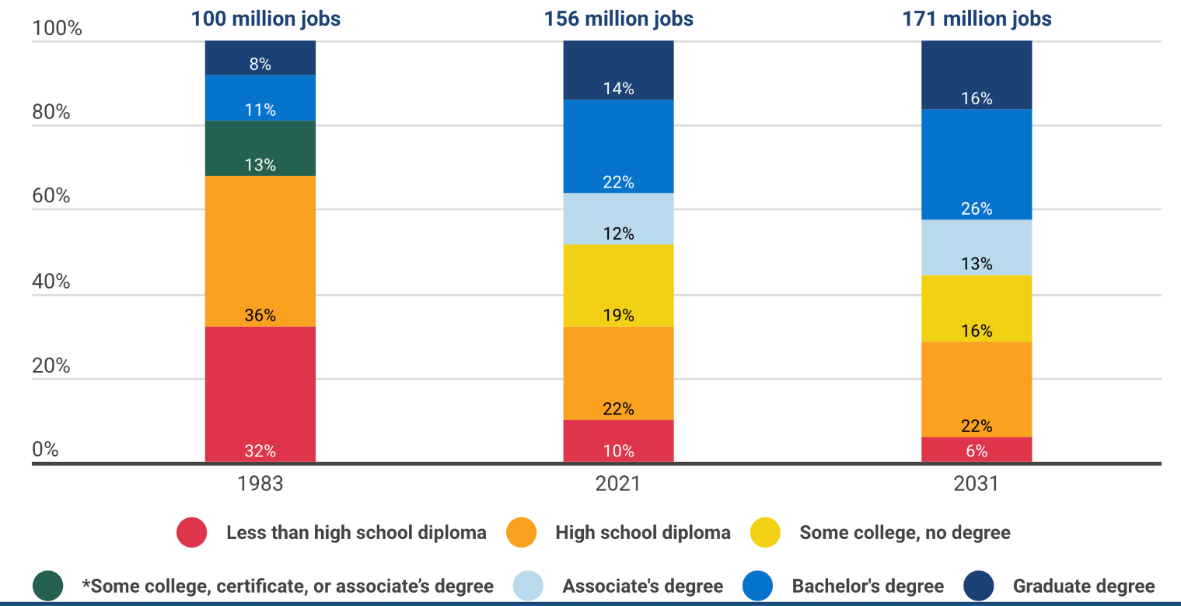
But – the Workforce is Changing
72%
Number of jobs that will require some college by 2031

Slide 11
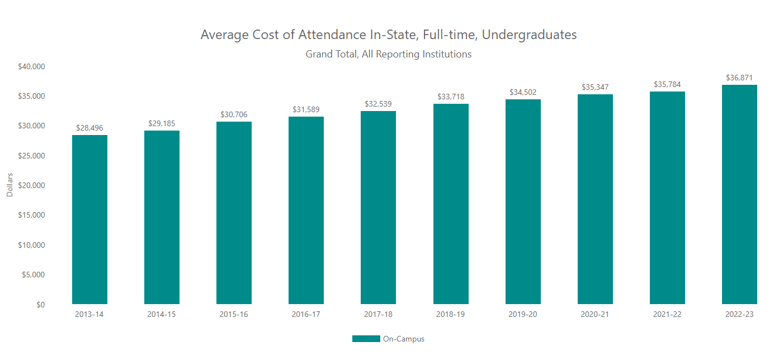
Cost of Attendance Increases

Slide 12
Governance Roles in Higher Education
Governor
Appoints members to the BOVs, the SBCC, & SCHEV Council
Issues executive orders
Prepares and submits a biennial budget
General Assembly
Confirms Governor’s board nominees
Adopts a biennial budget
Enacts legislation pertaining to higher education

Slide 13
Governance Roles in Higher Education
Institutions’ Governing Boards (BOVs & SBCC)
Sets institutional policy goals & priorities
Selects, reviews, & when necessary, dismisses the institution’s chief executive officer
Sets tuition & fees
Approves budget requests to the Governor & General Assembly
Ensures the institution’s efficient & effective use of state funds

Slide 14
Governance Roles in Higher Education
State Council of Higher Education for Virginia (SCHEV)
Develops a statewide strategic plan
Provides policy & budget recommendations
Reviews & approves/disapproves changes to public institutions’ missions & proposals of new degree programs
Administers state student-aid programs

Slide 15
Governance Roles in Higher Education
Key State Committees
[Six Person] Operating Advisory Committee (Op-Six) – reviews and provides feedback on institutions’ six-year operating plans
[Six Year] Capital Outlay Plan Advisory Committee (6-PAC) – reviews institutions’ six-year capital outlay plans and makes recommendations to the General Assembly

Slide 16
State Council of Higher Education
Coordinating body for Virginia higher education
Approval authority for certain academic matters at public institutions
Advisory services to certain private, nonprofit institutions
Regulatory authority for certain private, for-profit and out-of-state institutions
Various specific statutory duties, including
Statewide strategic plan, at least every six years
Review & approve/disapprove public institutions’ enrollment projections
Develop a uniform, comprehensive data information system
“Educational programs” for appointees to public institutions’ governing boards

Slide 17
Accrediting Bodies
Types of Accreditation
Institutional Accreditation – broad accreditation for institutions
Programmatic Accreditation - narrow, program-specific (eg, certain health programs, law schools, business schools, engineering, etc.)
Implications
Accreditation by a nationally recognized (ie, US Department of Education’s National Advisory Committee on Institutional Quality and Integrity) required for federal financial aid program participation

Slide 18
Educational Programs for New Board Members
§ 23.1-1304. Governing boards; additional duties; educational programs.
A. … [SCHEV] Council shall develop, in consultation with public institutions of higher education and members of their governing boards, and annually deliver educational programs for the governing boards of such institutions. New members of such governing boards shall participate, at least once during their first two years of membership, in the programs, which shall be designed to address the role, duties, and responsibilities of the governing boards and may include in-service programs on current issues in higher education. …
B. Educational programs for the governing boards of public institutions of higher education shall include presentations relating to: [19 topics are enumerated, the final of which is “any other topics” deemed “necessary or appropriate.”]

Slide 19
Statewide Strategic Plan
“Pathways to Opportunity: The Virginia Plan for Higher Education” (2021)
Mission: Virginia will advance equitable, affordable and
transformative higher education.
Vision: Best State for Education
Target: 70% educational attainment by 2030
https://www.schev.edu/research-publications/strategic-plan

Slide 20
“Pathways to Opportunity: The Virginia Plan”
Why a Statewide Strategic Plan for Higher Education?
Shifting demographics
Gaps in participation and completion by gender, region, race/ethnicity and socioeconomic status
Increasing demands for education and training by employers
Resource constraints – public funds and tuition and fees
De-centralized (and robust) system

Slide 21
What are our Strengths and Challenges?
ACCESS and COMPLETION
Strengths/Opportunities Graduation rates high at baccalaureate institutions Institution and community-based efforts to support access and completion Robust outreach to PK-12 Student transfer between community colleges and universities | Challenges/Threats Lower enrollment and completion by Hispanic, African-American, low-income and male students Lower graduation rates at community colleges Lack of awareness of the value of higher education and of postsecondary opportunities among too many middle- and high-school students

Slide 22
What are our Strengths and Challenges?
AFFORDABILITY and EXCELLENCE
Strengths/Opportunities Low average net price (discount after aid) at several institutions Higher average student financial aid compared to other states Leveling off of student debt Lower tuition and fee increases in recent years | Challenges/Threats “Sticker shock” of college costs Higher tuition and fees/lower state support for operations Variability in state support Faculty salaries low compared to peer institutions (34th percentile)

Slide 23
What are our Strengths and Challenges?
TRANSFORMATION and PROSPERITY
Strengths/Opportunities $1 billion to meet tech talent initiative Increased graduates in STEM-H related fields Alignment of degree programs to workforce/skills needs Funding and implementation of statewide internship program and non-degree credentials | Challenges/Threats Shortages in many employment sectors, such as health care, teaching, computer science and skilled trades Retention of graduates in Virginia Expected shortages in sub-baccalaureate credentials (associate degrees, certificates and industry certifications) Potential economic downturn

Slide 24
Student Aid Resources by Sector
Four-Year Public Institutions Two-Year Public Institutions
Includes grants, scholarships, tuition waivers, work study, and loans.
SCHEV Data: online FA17 report - 2022-23 financial aid data in millions; all students, all degree levels

Slide 25
Student Aid Type by Sector
Four-Year Public Institutions Two-Year Public Institutions
Includes grants, scholarships, tuition waivers, work study, and loans.
SCHEV Data: online FA16 report - 2022-23 financial aid data in millions; all students, all degree levels

Slide 26
Federal Student Aid
Primarily composed of the federal Pell grant targeting low-income students.
Provides student loans that can be available across income groups, but with varying interest terms.
The federal Free Application for Federal Student Aid (FAFSA) assigns a Student Aid Index that determines eligibility for the Pell grant but is also used by the state and institutions to allocate need-based financial aid.

Slide 27
State Financial Aid
Direct appropriation to each institution (VCCS as a system).
One funding source (Virginia Student Financial Assistance Program) funds two primary state need-based programs: the Commonwealth Award and the Virginia Guaranteed Assistance Grant.
State describes the eligible student but the institution has some discretion on the award amounts.
SCHEV makes funding recommendations that direct more state funds to those institutions having the largest average need per student.
Several smaller programs are designed to incent students to consider transfer programs and address workforce shortage areas.
Provides tuition waiver programs for specific populations.

Slide 28
Institution Aid and Endowments
Programs that do not have a direct impact on the institution’s operating budget:
Grants and scholarships from endowments funded by outside sources.
Grants and scholarships from institutional non-tuition revenues.
Programs that have a direct impact the institution’s operating budget:
Tuition Waivers – foregone revenue; most programs are state-required, some are institution optional.
Unfunded Scholarships – foregone revenue (revenue not collected) due to reducing tuition costs to the student.
Tuition Revenue Used for Aid – redirected tuition revenue, tuition collected but for purpose of funding financial aid.

Slide 29
Affordability
Student affordability is impacted by hundreds of decision points across federal, state, and institution policies and funding as well as individual decisions made by students.
As those closest to the student experience, consider how the results of the institution’s tuition and financial aid policies collectively impact students.
Affordability metrics to watch:
Average loan debt, percent of students borrowing, unmet need
Over reliance on private student loans and federal parent PLUS loans, especially for low-income families
Degree completion rates

Slide 30
Degree Completion
Consider the completion rates for low-income students as compared to other income populations.
Consider how the institution can lean into its commitment to student success by addressing barriers to completion and providing robust support services.
Ex: tutoring, early warning measures, mentorship, student sense of belonging, food insecurity, safety, mental health, emergency assistance grants, etc.
The Commonwealth has made an annual $37.5 million commitment to enable institutions to increase enrollment and retention rates for low-income students.
FY2026 application process kicked off October 28
Consider proactive rather than passive programs: Don’t create programs for students that need them; create programs that look for students that need them.

Slide 31
Direction and Priorities
OKRs
Flexibility & Innovation
Alignment to Workforce
Quality, Efficiency and Effectiveness
Access/Affordability & Costs
Supporting Vulnerable Populations
Data-Driven
Student Centric
Outcomes Focused
Trusted Experts
Mission Dedicated

Slide 32
Priority Initiatives
Access/Affordability/Costs
Alignment to the Workforce
Innovation and Flexibility
Vulnerable populations

Slide 33
Aligning for Success
Current State
Future State
State Strategic Plan
State Strategic Plan
Six-year plans (and updates)
Six-year plans (and updates)
Data (fact packs)
SCHEV Data (fact packs)
BOV Planning
BOV Planning
Tools
Program Approval
Institutional Performance Standards
Research and Reporting
Program Productivity
Learning Assessment
Etc.

Slide 34
Considerations of Public-institution Boards
What are the roles of our public institutions in:
Providing affordable access to all?
Improving student success for work and life?
Driving change and improvement in education?
Expanding prosperity and transforming the social, cultural and economic well-being of individuals, communities, regions and the Commonwealth?

