Slide 1
Governance 101
Armand Alacbay, Chief of Staff & Senior VP for Strategy
American Council of Trustees and Alumni (ACTA)
www.GoACTA.org

Slide 2
Public Boards vs. Private Boards

Slide 3
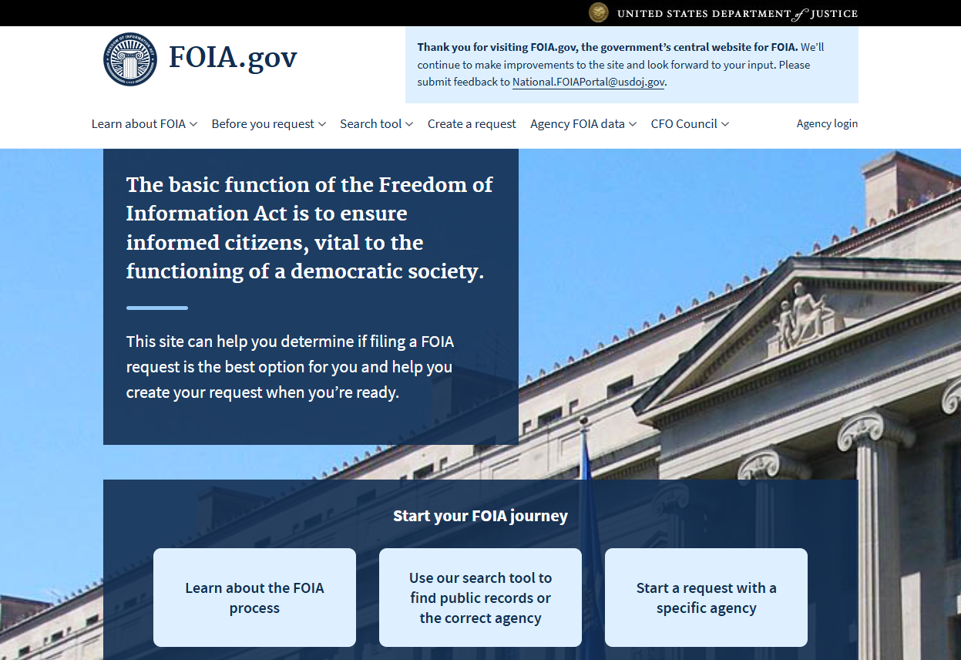
FOIA/ Open Meeting Laws

Slide 4
Duty of Duty to
Care
Loyalty
Obedience
The Commonwealth

Slide 5
“My role as regent, I think, is to ensure that the university does well and is fiscally sound and obeys laws in all of the policies we set out….
We’re not here to win awards, we’re not here to make the U.S. News and World Report’s best rank list—all of which are amazing and great, important things—but rather our main focus needs to be: How do we serve the people of this state?”

Slide 6
“Do you trust yourself to assess your university’s problems honestly?”

Slide 7
Higher Education Boards vs. Other Boards

Slide 8
“Shared governance—which demands an inclusive decision-making process—cannot and must not be an excuse for board inaction at a time when America’s pre-eminent role in higher education is threatened.”

Slide 9
www.WhatWillTheyLearn.com

Slide 11
ACTA Gold Standard for Freedom of Expression
Commit to a Culture of Freedom of Expression
Foster Civil Discourse
Cultivate Intellectual Diversity
Break Down Barriers to Freedom of Expression
Advance Leadership Accountability

Slide 12
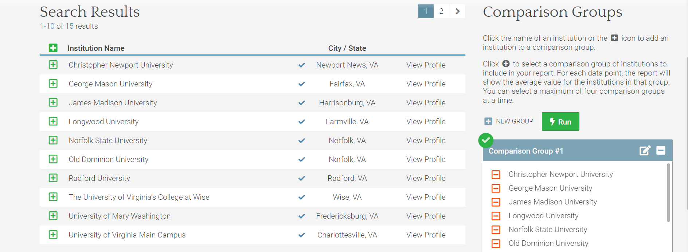
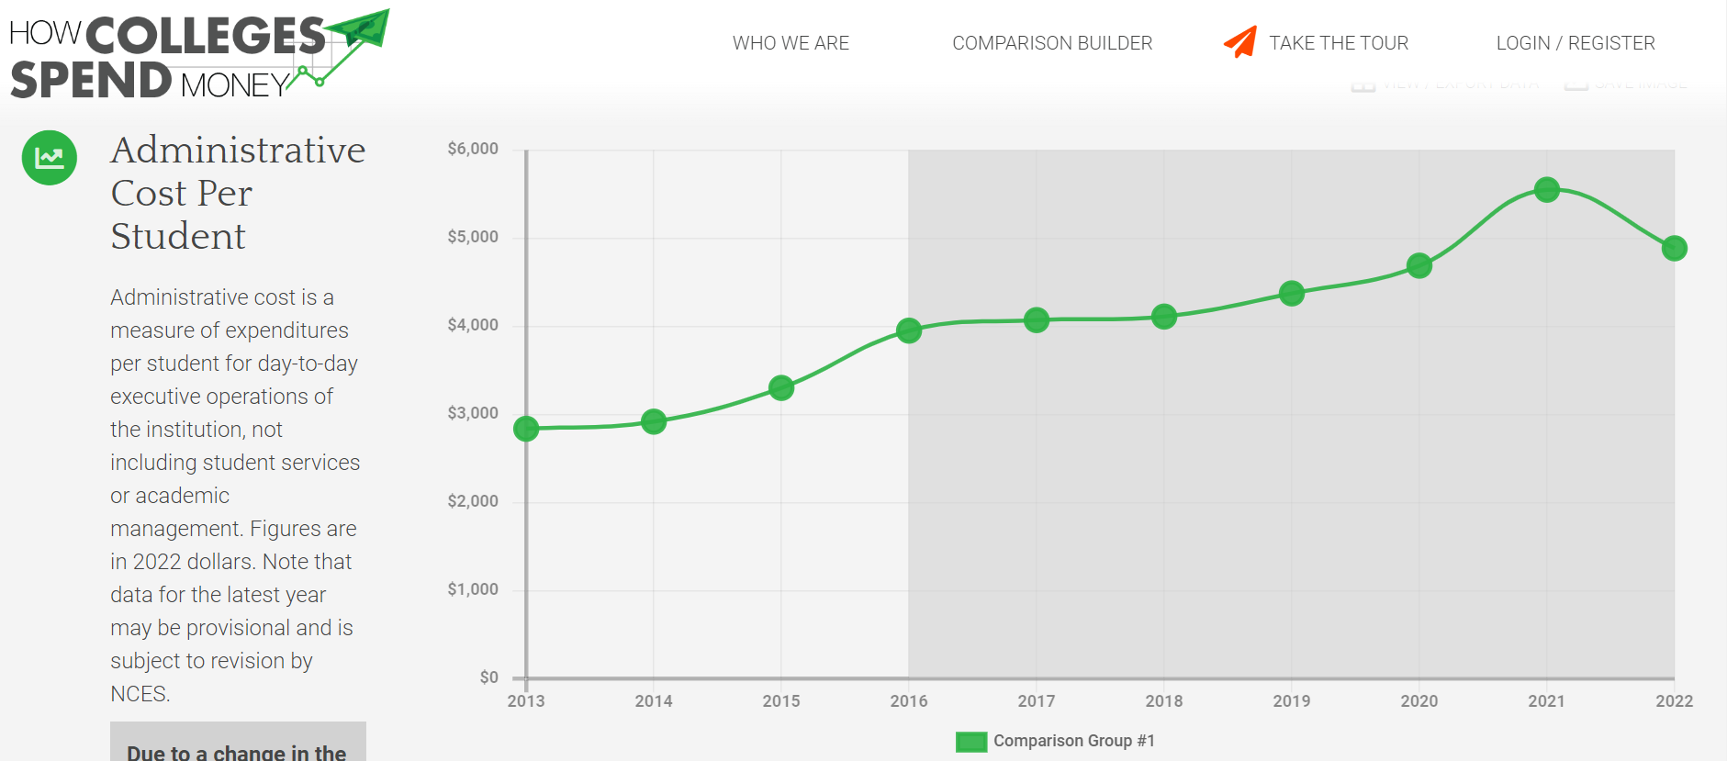
www.HowCollegesSpendMoney.com

