Slide 1
Welcome Slide
SCHEV Boards of Visitors Orientation
November 13, 2024
David Doré, Ed.D.
Chancellor
Notes:
Title Slide: Intro
Introduce yourself
Provide brief overview of the Virginia Community College System.
The Virginia Community College System serves 232,000 students annually at 23 colleges, 40 campuses and hundreds of locations.
The network of Virginia’s Community Colleges is the only provider of workforce and education solutions with true statewide scope, uniquely attuned to both the broad needs of the commonwealth and the nuanced needs of its communities.
A few key components to our success include 1) a metrics-driven strategic plan aligned to state-wide priorities, 2) the engagement of our State Board with our strategic plan and priorities and, 2) our system’s and colleges’ engagement with business and industry throughout the Commonwealth.

Slide 2
300,000
credentials
by 2030
Notes:
2. Accelerate Opportunity: 300,000 credentials
Starting with the big picture – what guides the day-to-day work of the State Board and our system –
When I started with the VCCS in April 2023, I immediately began working closely with the State Board, meeting with our legislators, and set out on listening tours at the 23 colleges to better understand the needs of our students and the business community.
By the summer, we began crafting our six-year plan. The process was iterative and collaborative. The State Board, our 23 college presidents, and system office leadership developed the plan together, aligned with state-wide priorities.
That plan served as the basis for our new strategic plan, Accelerate Opportunity, which was also developed in partnership with the State Board, our college presidents, and system office leadership.
Accelerate Opportunity launched in August and is very aligned with the Commonwealth’s workforce needs with a core focus on providing all students with the knowledge, skills, and credentials necessary for success in the 21st century.
Across our 23 colleges, our overarching goal is to provide 300,000 cumulative meaningful credentials by 2030 through accelerated access and success for every student.
With this new plan, we have shifted more and more to a metrics-focused, data driven culture, and we have shifted the goal line from completion to a good paying job in a high demand field.
Our 31 smart metrics touch on everything from increasing enrollment and completion to increasing graduates employed in high-demand career fields and increasing the numbers of graduates achieving upward mobility.
From our State Board’s perspective, everything we do at our State Board meetings and as a system should be tied to our overarching goal and our strategic plan objectives.
Board committees are assigned to each of the strategic plan objectives.
I will be evaluated on a set of very specific smart goals approved by the State Board that are directly aligned to Accelerate Opportunity
In turn, each college president will have their own annual goals and metrics directly tied to strategic plan objectives based on their students and communities needs.
In terms of specific programs and degrees or credentials, our State Board wants to consider several things:
Will this training meet the needs of a growing workforce?
Is there upward mobility and potential for stackable credentials;
Are these high-wage, high-demand occupations that will increase social mobility? Or will there be a saturated market, making it hard for newly trained students to secure careers in that field?
And are these the right credentials and training to meet the growing needs of employers?

Slide 3
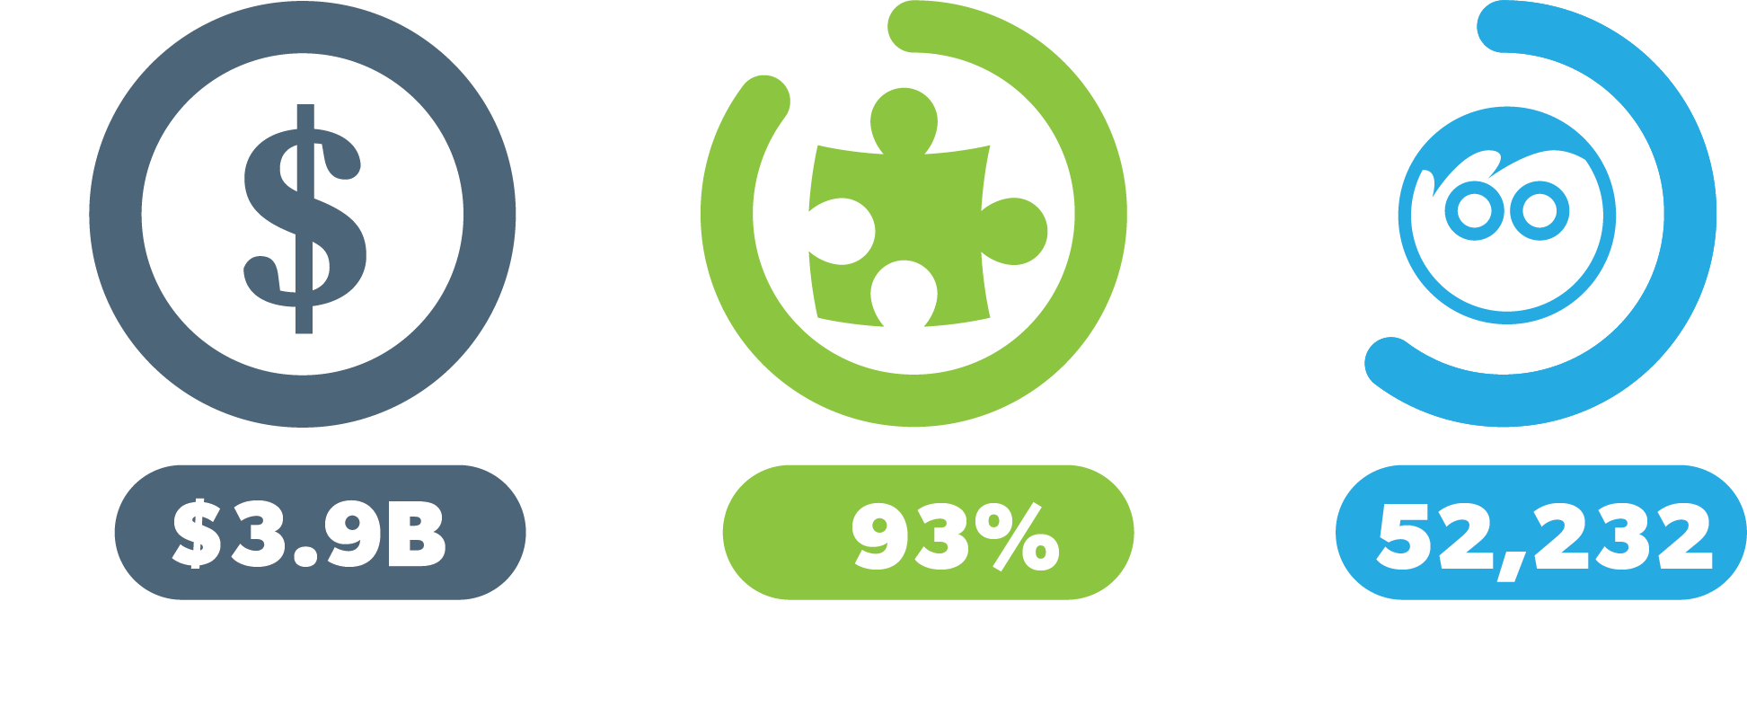
$85.5M
INVESTMENT
$12k+
95%
53,900+
Average Increase in Median Annual Wages
Program
Completion
Credentials
Earned
Source: VCCS FastForward administrative data and VEC records as of July 1, 2023
Notes:
5. Program Approvals and FastForward
Depending on the types of programs, there are varying levels of reviews and approvals that start at the college level before new programs can be approved.
Whether it’s an associates degree or a FastForward credential program, our State Board for Community Colleges gains a fair understanding of growing business needs and new program development at each of the colleges and provides input into strengthening our programs.
In many cases, credentials are standardized across the Commonwealth to better serve regional and statewide needs, but in some cases, customized training better meets the needs of employers' specialized demands.
For example, we have a first-in-class, short-term credential pay for performance program called FastForward that ONLY delivers what regions need in the form of workforce credentials.
According to the Virginia Employment Commission, by 2026, there are expected to be 2.6M middle-skilled jobs in Virginia – jobs that require some postsecondary education and training, but not a four-year degree.
Our FastForward program prepares students to earn third-party industry-recognized credentials in as little as 6-12 weeks, in over 40 fields including healthcare.
Many of the programs are stackable, meaning that students may complete the short-term credential, then go straight to employment, or continue to earn a certificate or associate's degree.
Through FastForward, students can also enroll and complete their programs at low cost with a ⅔ tuition discount. Eligible participants may get the remaining ⅓ covered through a program called G3 or other financial aid options provided at the colleges.
We have seen fantastic results with the successful FastForward programs:
Program graduates typically earn an average pay increase of $12,000 when they secure a job in their field.
Since its inception in 2016, the Commonwealth has invested $85.5million into FastForward.
Over 53,000 credentials have been earned, and graduates have earned over $4.6 billion in wages.
And because employers work with community colleges to customize the FastForward training programs, they gain access to a pool of candidates who are already skilled and prepared, streamlining the hiring process.
THE STATE BOARD APPROVES ALL FASTFORWARD PROGRAMS – INSERT APPROVAL PROCESS…

Slide 4
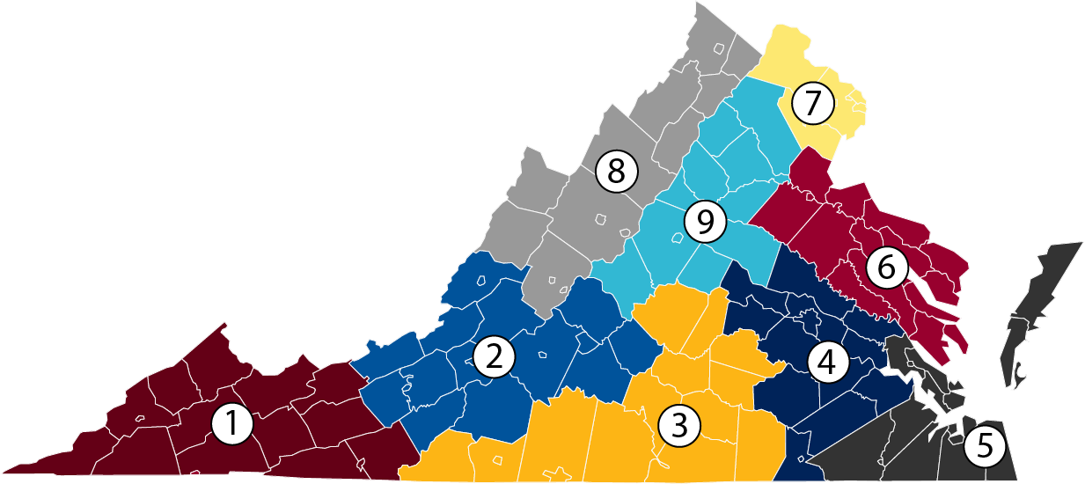
Source: GOVIRGINIA.ORG
Notes:
3. GO Virginia
So now, I’d like to discuss a bit about our engagement with business and industry and how that translates into developing our programs.
Virginia’s 23 community colleges have growing partnerships with business and industry in their service regions.
Employers serve on program advisory committees and provide our colleges with invaluable information regarding credential needs, relevant training and equipment, and especially what’s needed and expected in the talent workforce and how we can better prepare our students for those positions.
This applies to both program development and program revision, as we work to keep our training fresh and relevant. We have found so many employers also donate equipment to our colleges so students can learn on the exact equipment used in the field.
So, I’ll share one specific example of how we have really worked to engage business and industry in new ways.
Systemwide, throughout the last year, Virginia’s Community Colleges have worked together to realign our collective efforts around the nine GO Virginia Regions.
We looked closely at VOEE data to identify the industries of highest demand and greatest need within each of the GO Virginia regions, and that told us which programs we needed to scale at our colleges and served as the basis for our legislative priorities.
Beyond state funds, our colleges have been increasingly focused on seeking partnerships and private investment to scale in-demand programs.
Looking more regionally helps ensure that our colleges are working collaboratively with each other, instead of in competition; are having conversations to meet critical regional workforce needs; and are remaining key contributors in regional economic development.

Slide 5
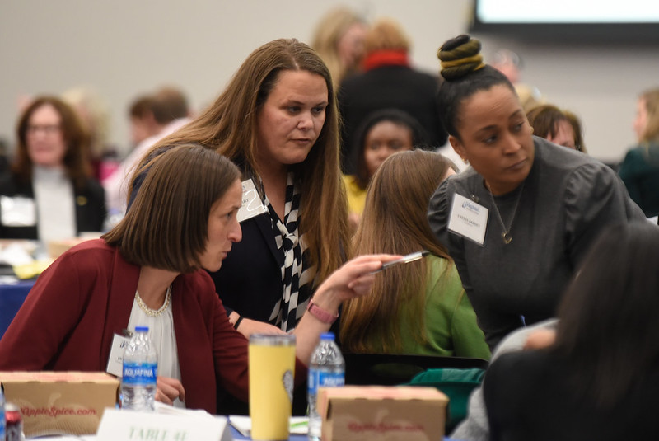
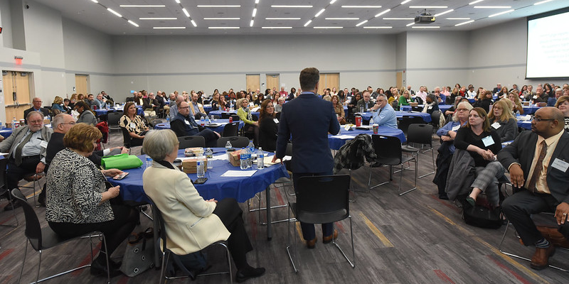
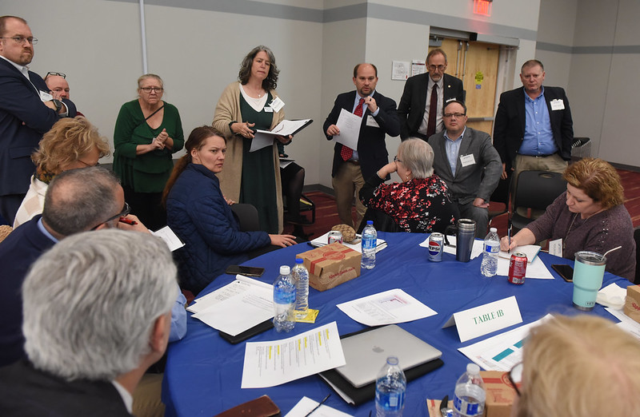
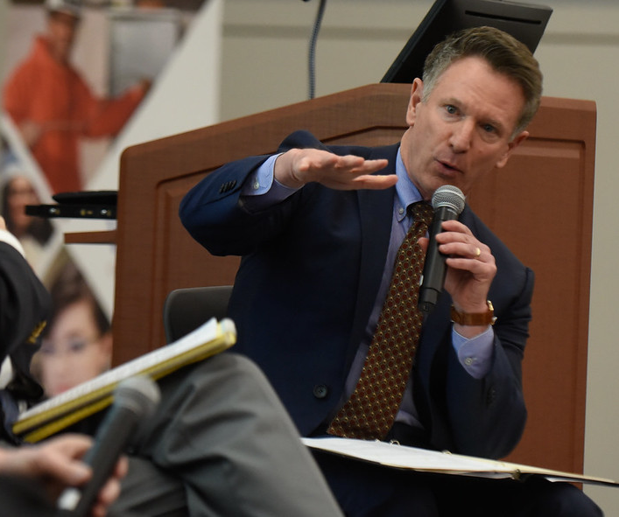
2024 Healthcare Summit
Notes:
4. Healthcare Summit
Last year, we expanded our regional outreach efforts on a statewide basis with industry summits - bringing business and industry, partners, and our colleges together for a deep-dive into determining workforce needs and how our community colleges can better serve employers and our students.
In 2023, we held our first Healthcare Summit and we recently held our Skilled Trades Summit. The participation and feedback has been truly amazing.
And we are starting to see the results of this increased collaboration through development of new programs and partnerships, and scaling and replication of existing programs (such as the replication of the Blue Ridge Partnership for Health Sciences).
The Hampton Roads Workforce Council is working with colleges in their GO Virginia region to replicate the success of the Blue Ridge Partnership for Health Sciences in their own GO Virginia region -

Slide 6
The median wage of G3 completers increased by 95%
within six months of graduation.
54% of G3 students had family income levels below 200% of the federal poverty level.
75% of G3 students re-enrolled the following year or graduated.
2,016 G3 students earned 2,799 associate degrees, certificates, and diplomas.
$30.5M
TUITION ASSISTANCE PER YEAR FOR CREDIT PROGRAMS
Source: 2022-23 G3 Annual Report, September 1, 2023
Notes:
6. Lessons Learned & G3
So, what are some lessons learned regarding aligning curriculum with workforce needs?
Let’s look at our G3 program.
For those unfamiliar, G3 is a last-dollar tuition assistance program for qualified students pursuing applied associate degrees in high-demand career fields.
G3 focuses on terminal associate degrees, not transfer degrees, in information technology, healthcare, public safety, skilled trades, and early childhood education.
As we have found with the expansion of G3, not all students in transfer degrees actually intend to transfer, but many do.
For example, some of our colleges only offer computer science degrees as transfer but there are students who want training in IT and computer science and don’t have other options.
With our Tech Talent Investment Program, these students are learning more about their transfer options and the amazing partnerships with 4-year institutions that lead to in-demand occupations.
Along with Credits2Careers and TransferVirginia, these students are finding out how many credits they can earn with credit for prior learning (CPL) and transfer and in-turn, how much time and money they can save towards completion of their baccalaureate program.

Slide 7
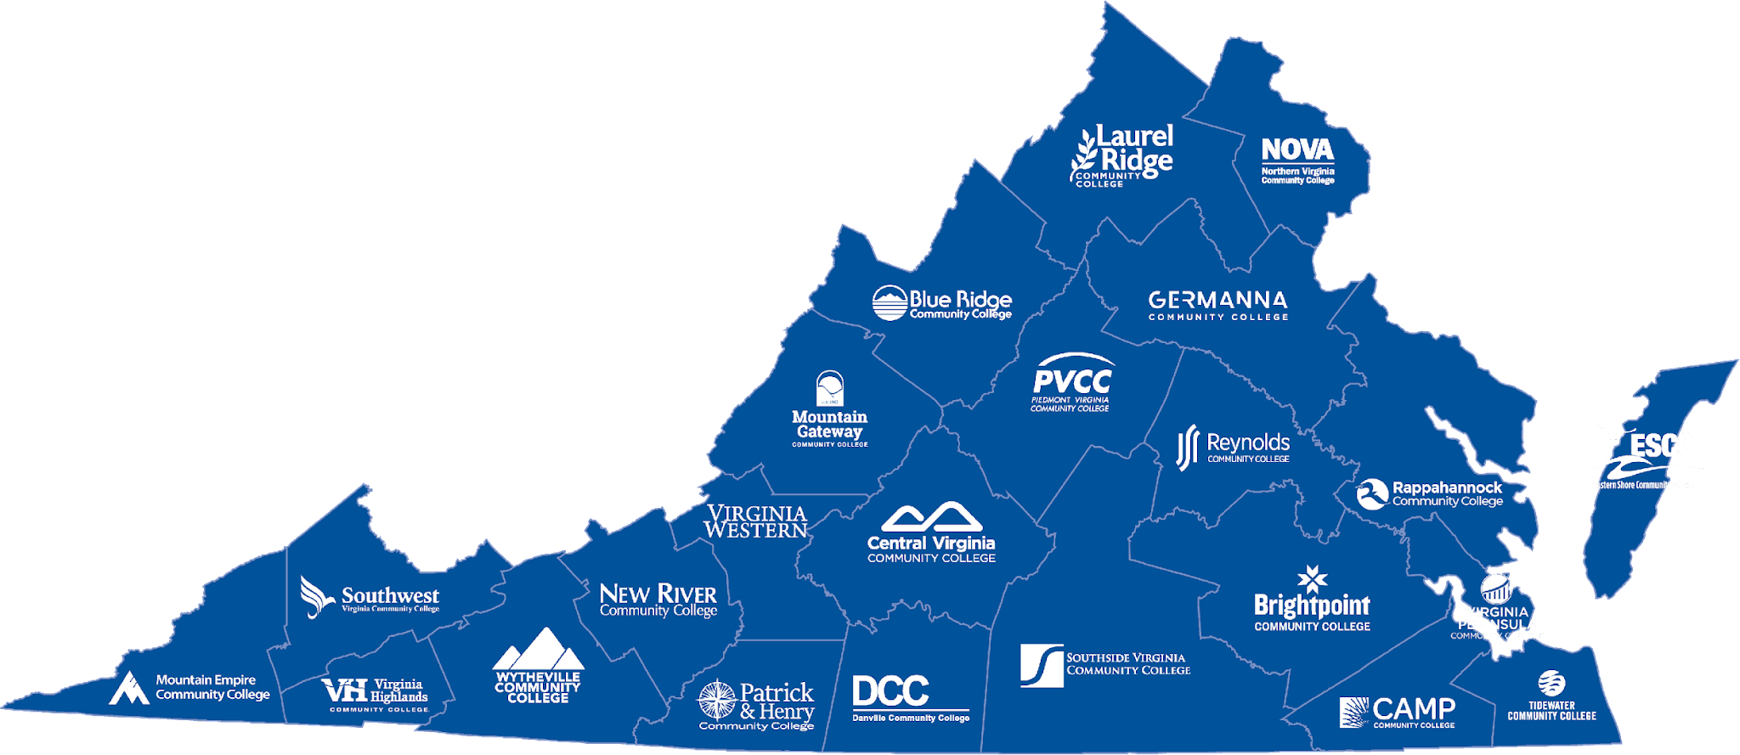
Notes:
7. Map Slide
What questions should board members ask of their executives/administrators?

