Slide 1
Higher Education
November 2024

Slide 2
Study resolution
Directed JLARC to review several aspects of state’s 15 public four-year higher education institutions
Resolution items addressed in two reports
Spending & Efficiency in Higher Education
Higher Education Institutional Viability
Commission resolution (December 11, 2023)

Slide 3
Higher education landscape
Student costs, spending, & efficiency
Institutional viability

Slide 4
Perception of need for a four-year degree has been shifting
Declining belief among some that four-year degrees are necessary or “worth it”
After decades of stagnation, earnings of those without a college degree have been increasing (though graduates from four-year institutions still make more, on average)

Slide 5
Students and families may be less willing to spend or borrow to earn a four-year degree in the future
Have a “great deal or quite a lot of confidence” in higher education (Gallup survey) | 57% (2015) | 36% (2024)
The cost of college is “worth it” (VCU survey) | 47% (2023) | 38% (2024)
“It’s less important to have a four-year college degree today in order to get a well-paying job than it was 20 years ago” (Pew Research survey) | ≈50% (2024)

Slide 6
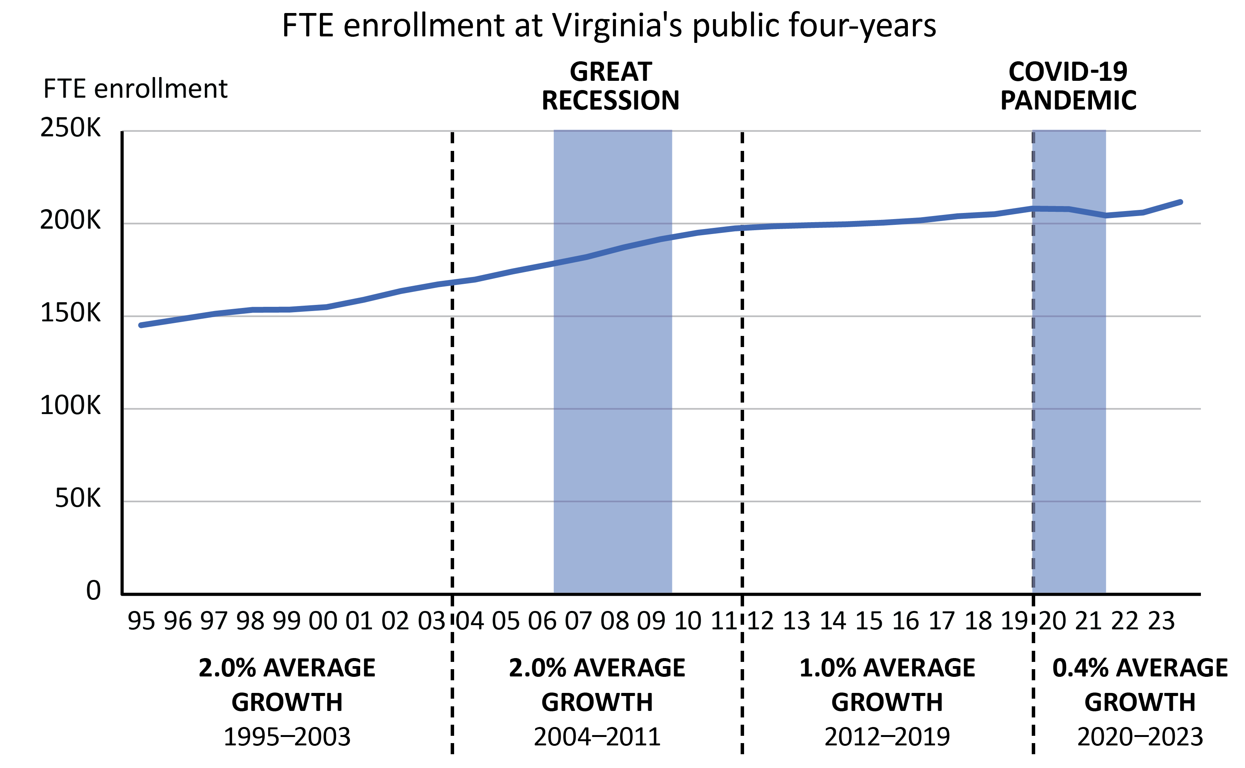
After decades of steady growth, enrollment growth has slowed overall at Virginia institutions
SOURCE: SCHEV FTE enrollment data for public four-year institutions, 2001–2023.

Slide 7
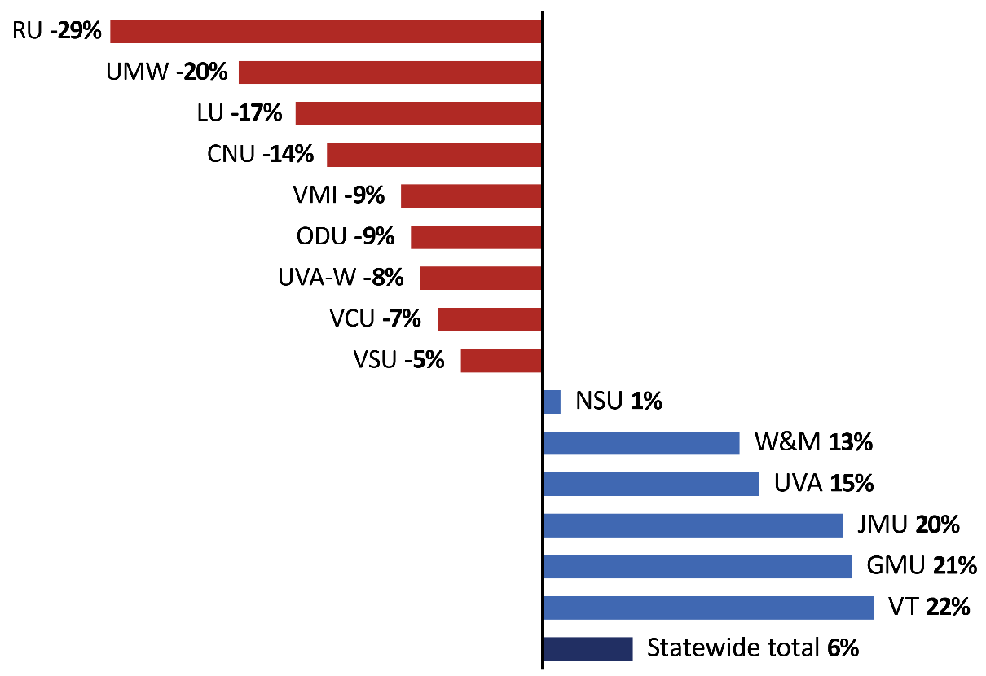
Slowing overall enrollment growth has resulted in substantial shift in “market share” among institutions
SOURCE: SCHEV FTE enrollment data, 2014–2023.

Slide 8
High school graduates are expected to peak in 2025
SOURCE: 2023 state high school graduate projections, U.S. Department of Education National Center for Education Statistics.

Slide 9
Higher education landscape
Student costs, spending, & efficiency
Institutional viability

Slide 10
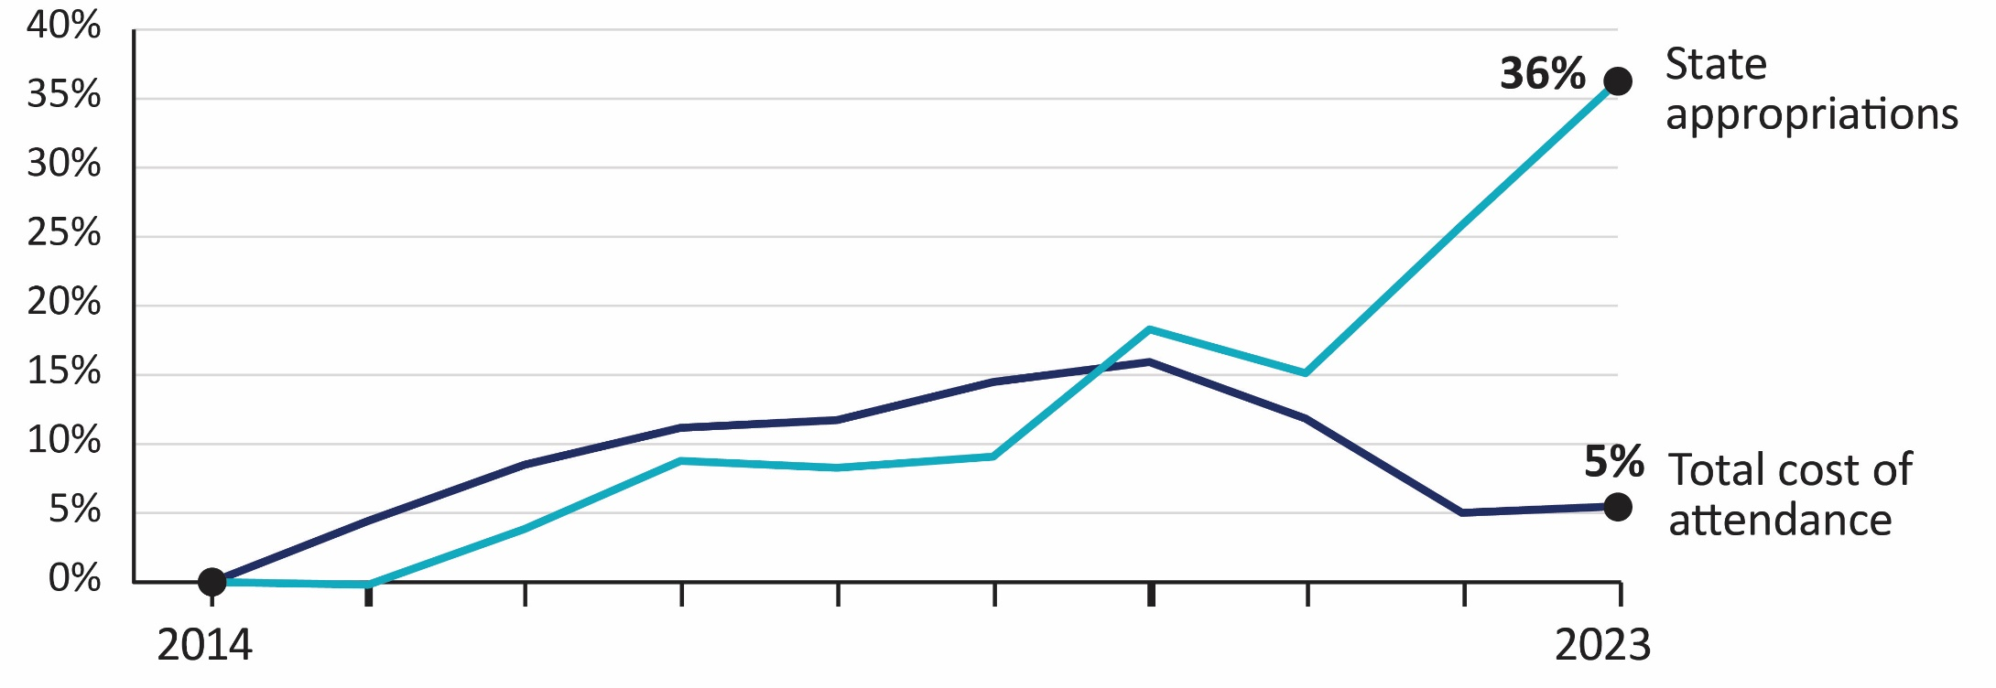
Cost of attendance improved as the state has appropriated more funds
Adjusted for inflation to 2023 dollars.

Slide 11
Virginia institutions continue to cost more to attend than public institutions nationwide (2022–23)
Average published price at Virginia institutions was about 9 percent higher
Average net price for an in-state, undergraduate student was about 21 percent higher

Slide 12
Many students still borrow to afford higher education, despite recent decreases in net price
At Virginia’s public four-year institutions:
54 percent of in-state students graduating with a bachelor’s degree borrowed
Average debt of graduating students is about $30,000, which has grown by 15 percent in the last decade
Virginia students borrow more on average than graduates from public institutions nationwide (about $27,000)
See Appendix E for more information on student debt.

Slide 13
Student need and institutions’ ability to provide aid contribute to student debt levels (FY24)
Debt of those students who graduate, as of FY22.

Slide 14
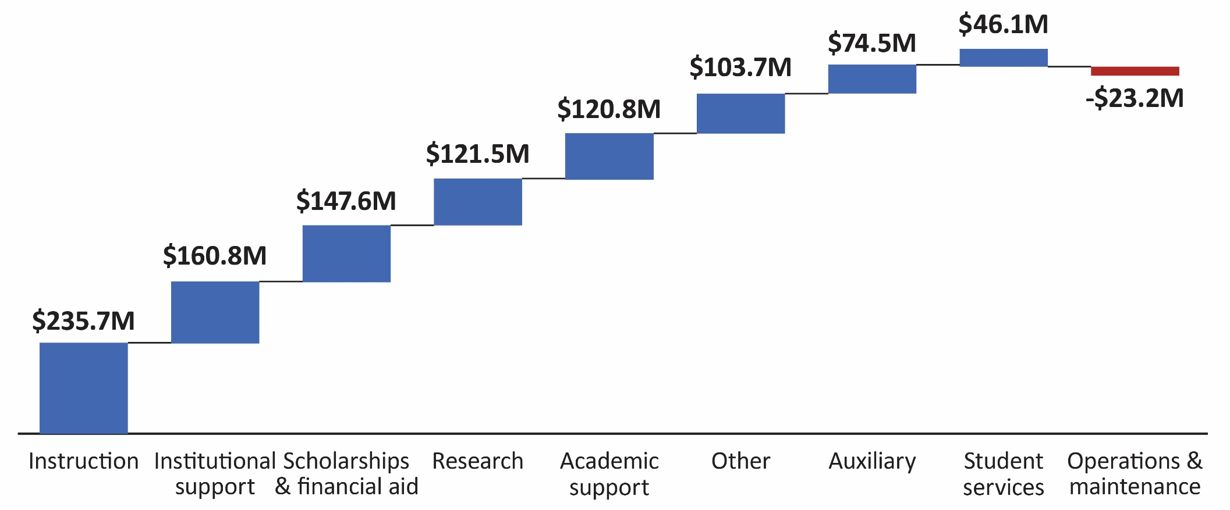
Instruction was largest driver of institutions’ spending growth in the last decade (FY14–FY23)
Adjusted for inflation to 2023 dollars.

Slide 15
Staffing grew by 4,900 positions (12%); largest growth was in business and finance (FY14–FY23)

Slide 16
10 Virginia institutions spend about the same as or less than similar institutions nationwide
Virginia Military Institute is excluded from analysis because it has few comparable institutions nationwide. Comparisons are for FY22, the most recent year available for national spending data.

Slide 17
Declining enrollment contributed to reduced spending efficiency
Institutions have fixed costs, such as facilities, that do not decrease when student enrollment drops
Declining enrollment, rather than major spending increases, was a primary driver of higher spending per student at most institutions
Increased spending per student can be concerning because it can result in higher student costs

Slide 18
Non-academic functions and scholarships & student aid were most common spending drivers
 | Per student spending change (FY14–FY23) | Instruction | Non-instruction functions | Auxiliary enterprises | Scholarships & aid | Institution- funded research
UVAW | 69% | ✓ | ✓ |  | ✓
NSU | 53 | ✓ | ✓ | ✓ | ✓
VSU | 38 |  | ✓ | ✓ | ✓
RU | 31
CNU | 26 |  | ✓ |  | ✓
UMW | 24 |  |  |  | ✓
VMI | 22 | ✓ |  | ✓ | ✓
ODU | 20 |  |  | ✓ | ✓
VCU | 17 |  | ✓ |  | ✓ | ✓
UVA | 16 | ✓ | ✓ | ✓ | ✓
LU | 11 |  |  | ✓
W&M | 2 |  |  |  | ✓
JMU | 2 |  |  |  | ✓
GMU | -1 |  | ✓
VT | -5 | ✓ |  |  | ✓

Slide 19
Institutions report implementing many efficiency and cost reduction strategies since 2021
Most common strategies were process redesigns, organizational changes, and contracting and shared services
These efforts produced a reported savings of ~$96 million annually; equal to about 1 percent of overall spending
*2021 used because SCHEV collected information from institutions for time period prior to 2021.

Slide 20
Some institutions have not implemented efficiency strategies in areas of spending growth
Some institutions are not consistently implementing efficiency strategies previously recommended by JLARC and subsequently required in Appropriation Act
Reviewing organizational structure can identify and improve efficiency in non-instructional staffing areas, such as business/finance
Spans of control policies and reviews can improve efficiency by reducing the number of managerial positions
Span of control is the average or median number of employees directly reporting to a manager.

Slide 21
Higher education landscape will likely consist of fewer students and more cost-conscious students
A majority of Virginia public institutions have already experienced a decline in enrollment
Demographic projections show institutions will be competing for fewer students in the near future
Changing higher education landscape will require institutions to further improve efficiency and focus on student costs

Slide 22
Institutions with declining enrollment will need to better align scale of operations with enrollment levels
Strategies include:
reducing staffing,
discontinuing less utilized academic programs, and
reducing unused square footage
Institutions’ six-year plans broadly address topics related to academics, financing, and enrollment
Six-year planning process could be used as a mechanism for institutions to identify ongoing or future efforts

Slide 23
Student fees for intercollegiate athletics vary widely but are substantial at certain institutions
Annual non-E&G fees for intercollegiate athletics (2024–25)

Slide 24
More focus is needed on student costs related to athletics spending
Legislation passed in 2015 limits the proportion of athletics revenue that can be funded by student fees and the institution, which has helped manage costs
However, as overall athletics revenue grows, so can student fees and institutional support
JMU athletics revenue grew $11.8 million over 10 years, $8.7 million funded by student fees and the institution without exceeding statutory limit
A cap could be imposed on student fees and institutional funds that can be spent on athletics; cap could be based on proportion of total cost of attendance

Slide 25
Higher education landscape
Student costs, spending, & efficiency
Institutional viability

Slide 26
Public higher education institutions do not tend to close, but attention to viability still critical
Since 2016, 120+ four-year higher education institutions closed or merged with another institution*
Most institutions that closed or merged were private, located in the Northeast or Great Lakes, and small
86% private institutions
63% in three regions with declining populations—New England, Great Lakes, and Mideast
Median enrollment was 702 students
Examples of public institution mergers in Pennsylvania, Georgia, Tennessee
*Excludes private for-profit institutions, two-year institutions, and professional/career institutions.

Slide 27
Researchers have used many frameworks and metrics to assess institutional viability
Several consulting groups, academic researchers, and state governments have developed frameworks to assess higher education institutional viability
Metrics in these frameworks typically include a combination of:
Student metrics (e.g., enrollment, graduation, retention, first-year student enrollment, admissions rate, yield)
Financial health metrics (e.g., primary reserve ratio, equity ratio, net income ratio, viability ratio)
Revenue metrics (e.g., discounting, state appropriations, endowment)

Slide 28
JLARC viability assessment uses multi-dimensional framework
Selectivity – Is the institution highly selective compared to other public institutions nationally?
8 viability risk factors in three areas
Students | Graduation rates (compared to predicted)
 | Enrollment (first-year students)
 | Retention
Institutional appeal | Pricing power (tuition revenue per FTE student)
 | Facility age/condition
Finances | Financial health ratios
 | State funds (per FTE student)
 | Endowment (per FTE student)

Slide 29
Ratings were at a recent point in time, and even very low-risk institutions need to manage operations well
JLARC viability ratings are at a recent point in time, but near-term (or current) trends could lead to specific risk factors improving or worsening
Viability = an institution’s ability to continue operating without needing major changes to survive (e.g., significant new funding or merger with another institution)
Even institutions with very low viability risk face a dynamic environment that could require operational changes (e.g., budget shortfalls, closing or opening new academic programs)

Slide 30
Seven institutions rated at relatively low or some viability risk and need to monitor risk factors
GMU, JMU, ODU, UVA, VCU, VMI, VT, W&M
RU, UMW, VSU
SOURCE: JLARC summary of viability risk assessment framework results, 2024.

Slide 31
Recent and ongoing developments could change viability risk assessment
Assessment represents a historical point-in-time review of viability risk for each of the state’s public four-year institutions
Recent developments or ongoing trends could change risk ratings for individual institutions. Examples include:
Fall 2024 enrollment
Changes in tuition discounting strategies
Improvements to campuses and buildings

Slide 32
Higher education six-year planning process has elements related to viability
Institutions are required to submit a six-year plan biennially in odd years
Several requirements of six-year plans related to viability:
Financial planning reflecting anticipated revenues
Identification of new programs or initiatives
Plans for optimal use of facilities and resources
Plans for resource-sharing programs with other institutions
Existing six-year planning process should be augmented to more fully assess viability

Slide 33
Conclusion
Full report details and recommendations available at
https://jlarc.virginia.gov/landing-2024-spending-and-efficiency-in-higher-education.asp
https://jlarc.virginia.gov/landing-2024-higher-education-institution-viability.asp

