Slide 1
Safety, Security, & Free Expression: How Can the BOV Support the Effort?
A Police Chief’s Perspective
Carl T. Rowan, Jr.
George Mason University Police Department

Slide 2
Understand the Training & Capabilities of Your Police Department
Do those capabilities match the needs of your institution?
Do you have a strong Threat Assessment Team, Clery Act manager, or Criminal Investigations Unit?
What percentage of your Department is trained in Crisis Intervention?
What is the state of your community policing effort?
Does your police department have strong relationships with surrounding departments for mutual aid purposes?
Does your police department interact synergistically with your academic units such as forensic science and criminology?

Slide 3
Does Your University Staff Value Law Enforcement? Confronting the “Barney Fife” Attitude vs. the Realities of Modern Policing
The need for highly professional and capable university police forces has accelerated over the past decade due to the need for more critical thinking, more technology, complex court cases, and societal demands.
Those changes may be lost on many university staffers who view the police as glorified security guards. That attitude shows itself in ways that are detrimental to public safety, including higher attrition and low morale.
If your org chart shows the police reporting to a second or third tier manager, that is not a good sign.

Slide 4
Best Practices to Consider for Maximizing the Potential of Your Police Force
In today’s world, the Chief of Police should be the direct report of someone in senior leadership, preferably someone in the Office of the President. There is a lot of very sensitive information that comes across our desks that we need to brief senior leadership about, and we need to do it personally, not through layers of bureaucracy.
If you have questions about police performance or the state of public safety, and the police are not participating in that briefing, ask why that is the case.

Slide 5
Best Practices, con’t
Quality pay is a necessity if your institution wants to retain its top talent. You don’t have to have the best pay scale in your region, but you need to be competitive.
Quality personnel will follow competitive pay. No successful organization is satisfied with hiring second rate, or third rate, personnel.
Quality training, in excess of the state minimum requirement (480 hours of approved basic training and 100 hours of field training), is highly recommended. By comparison, George Mason officers receive 817 hours of basic training and 480 hours of field training. Well trained officers have fewer complaints and performance problems.
If you have questions about the competency of your police force, consider having a peer review by other departments.
Finally, the BOV sets the tone for their institutions. Speaking up for the need to invest in quality campus law enforcement will motivate the bureaucracy to make that happen and also raise the morale of your police department.

Slide 6
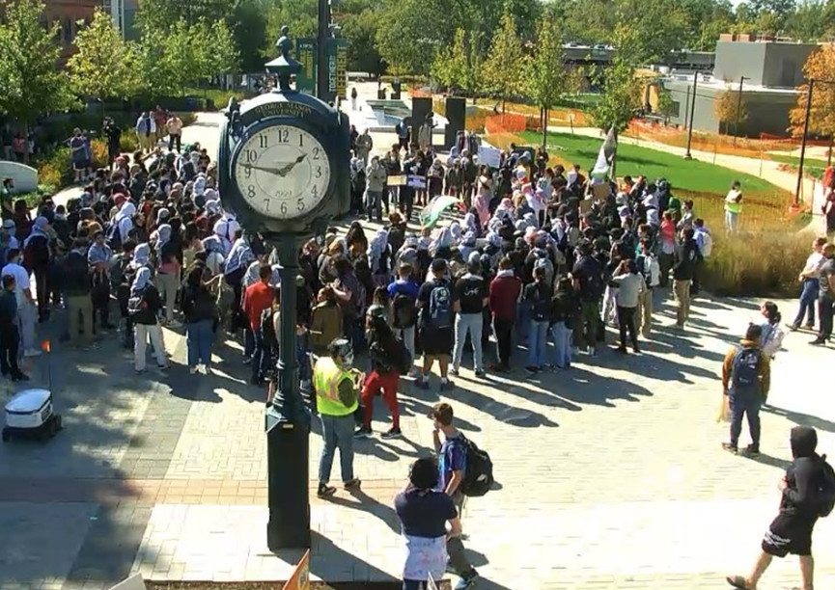
A Few Thoughts About Free Expression
Virginia Police officers take an oath to uphold the Constitutions of the United States and the Commonwealth of Virginia. It is an oath that we take very seriously, particularly the words of the 1st Amendment. We will vigorously protect and defend the right of people to peacefully protest at our state university. Our institution has carefully considered policies that codify that commitment to free speech while imposing reasonable regulations on the place and manner of the speech so as not to trample on the rights of those who want to conduct their campus business. Some of the speech can be disturbing and vile, but we protect that too. The concept of “hate speech” does not trump the Constitution.
That said, individuals who violate university policies and/or criminal statutes as a part of their free expression will, and should, be held to account. That is not an opinion of just the police department. It is the policy of George Mason University, and we stand as one on that issue.

Slide 7
Questions?
Carl T. Rowan, Jr.
Chief of Police & AVP of Public Safety
George Mason University
Cell: 202-438-2062
Email: crowan2@gmu.edu

