Slide 1
Turning Data Insights to Action: Transforming How We Work
Dr. Paula Pando, President
Dr. Paula Pando, President ppando@reynolds.edu

Slide 2
Deep Dive into Enrollment
Application Projections
Enrollment (Actual)
Enrollment Projections
FTES Projections
Market Penetration

Slide 3
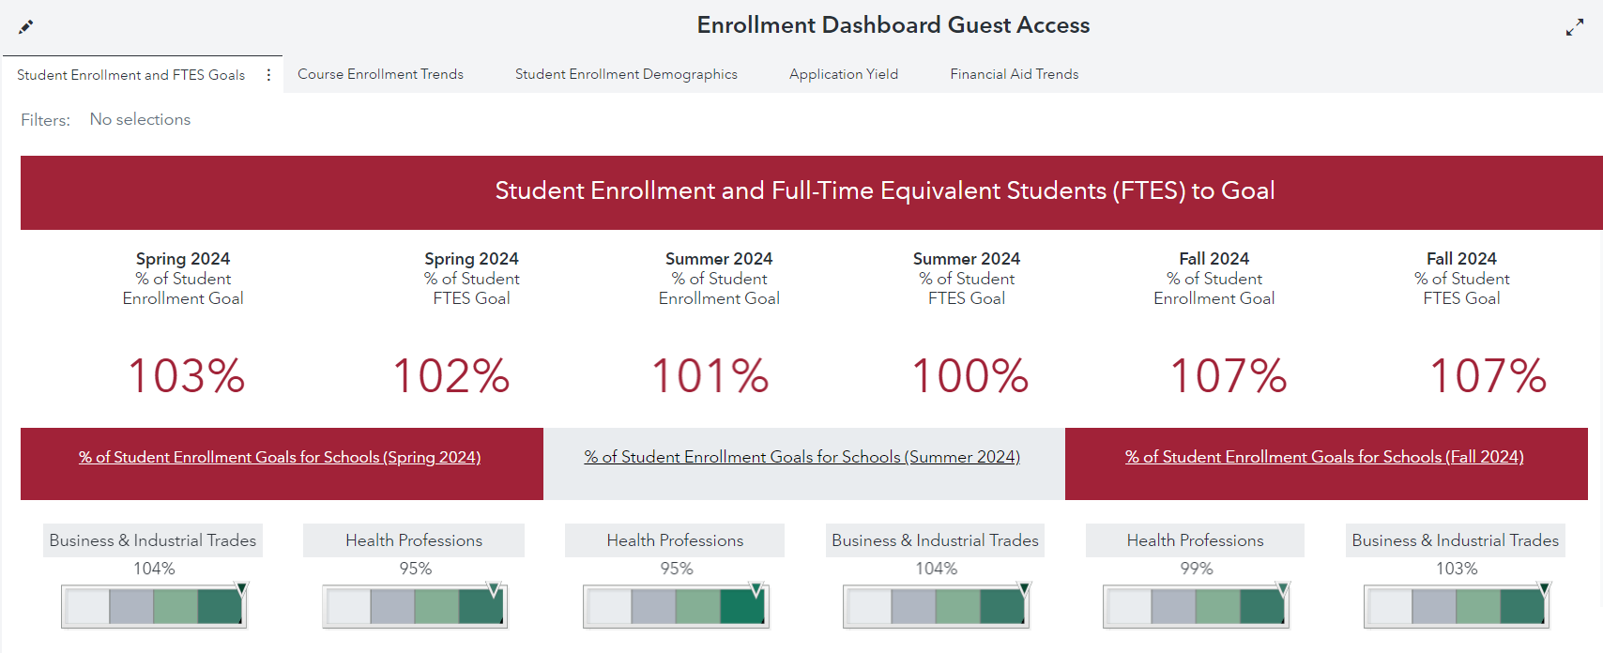
Enrollment Dashboard
People Play Differently when there is a Scoreboard

Slide 4
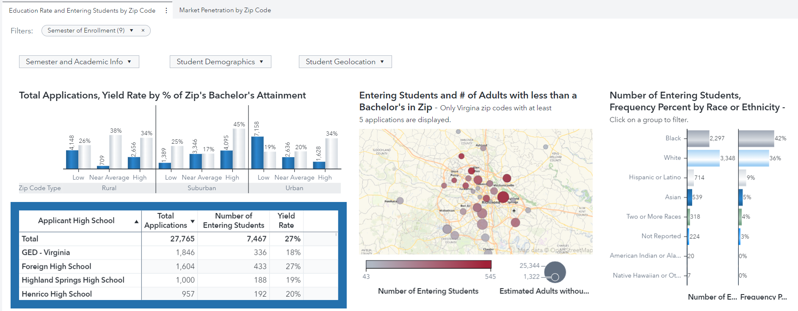
Market Penetration
+8% in application yield from fall 2023 to fall 2024

Slide 5
Student Success Dashboards
Academic Program Performance
College-wide Student Performance
Fall to Spring Retention Monitoring
Instructor Course Outcomes
Spring to Fall Retention Monitoring
Tutoring Trends and Outcomes

Slide 6
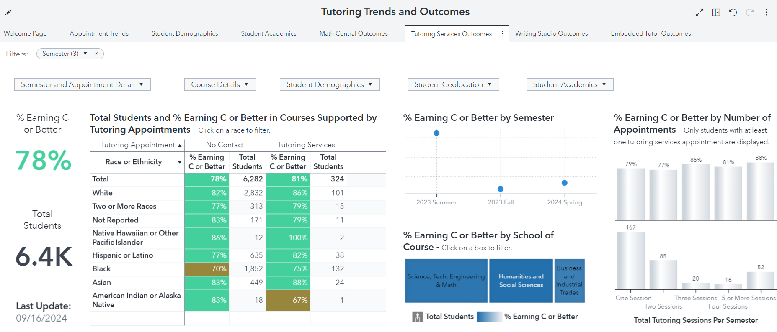
Tutoring Trends and Outcomes
On average, students receiving tutoring had a 3% higher success rate.

Slide 7
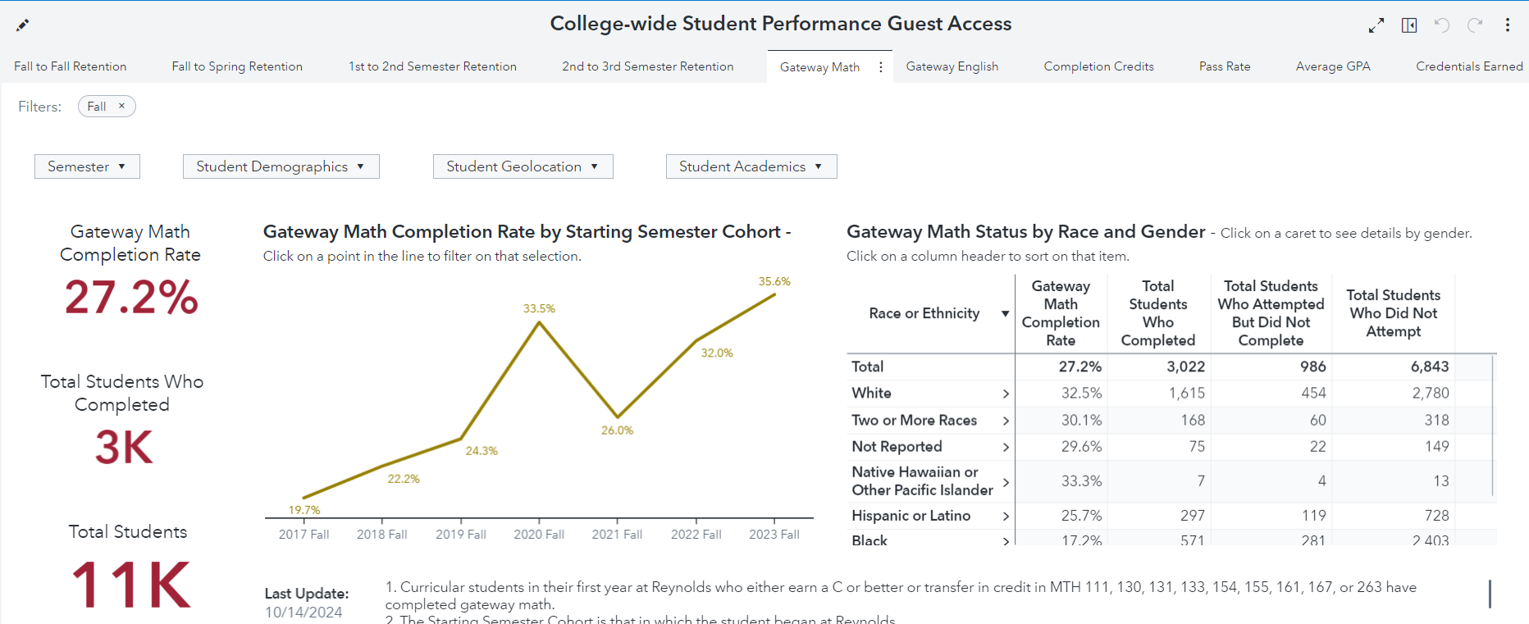
College-wide Student Performance
Upward trend in early momentum metrics predictive of graduation success

Slide 8
Administrative Dashboards
Building Utilization by Academic Courses
Course Efficiency and Faculty Staffing Model
Enrollment Cancellation Monitoring
Operating Budget and Expenditures

Slide 9
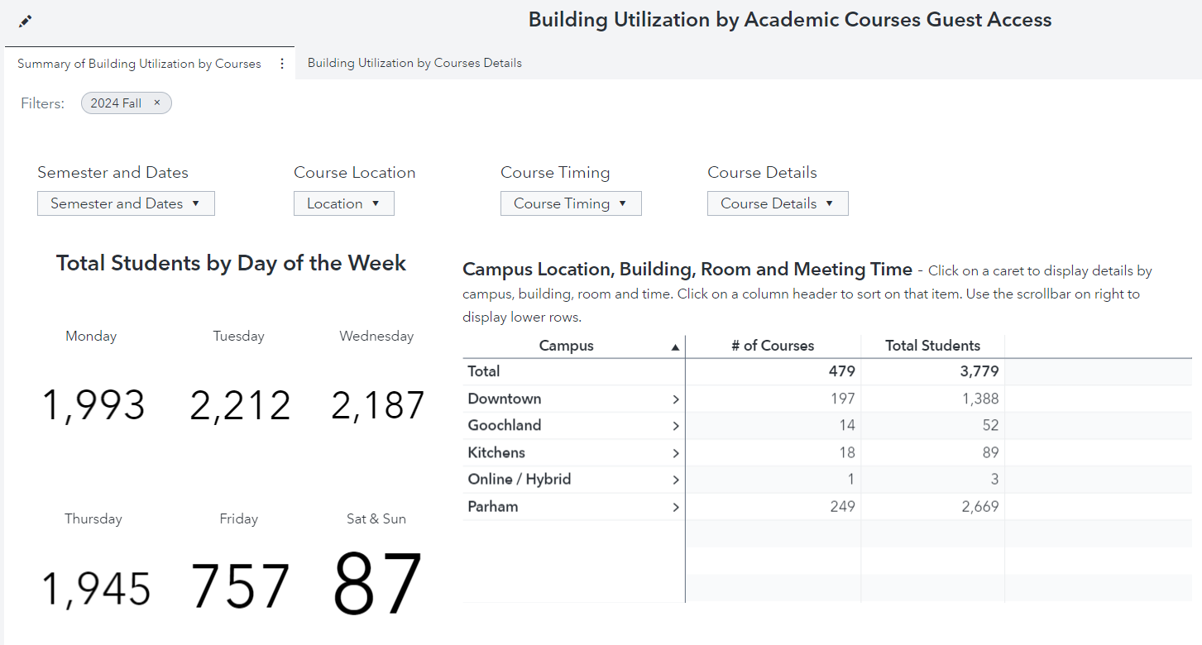
Building Utilization by Academic Courses
Analysis of building utilization resulting in
repurposing of unused/underused computer labs

Slide 10
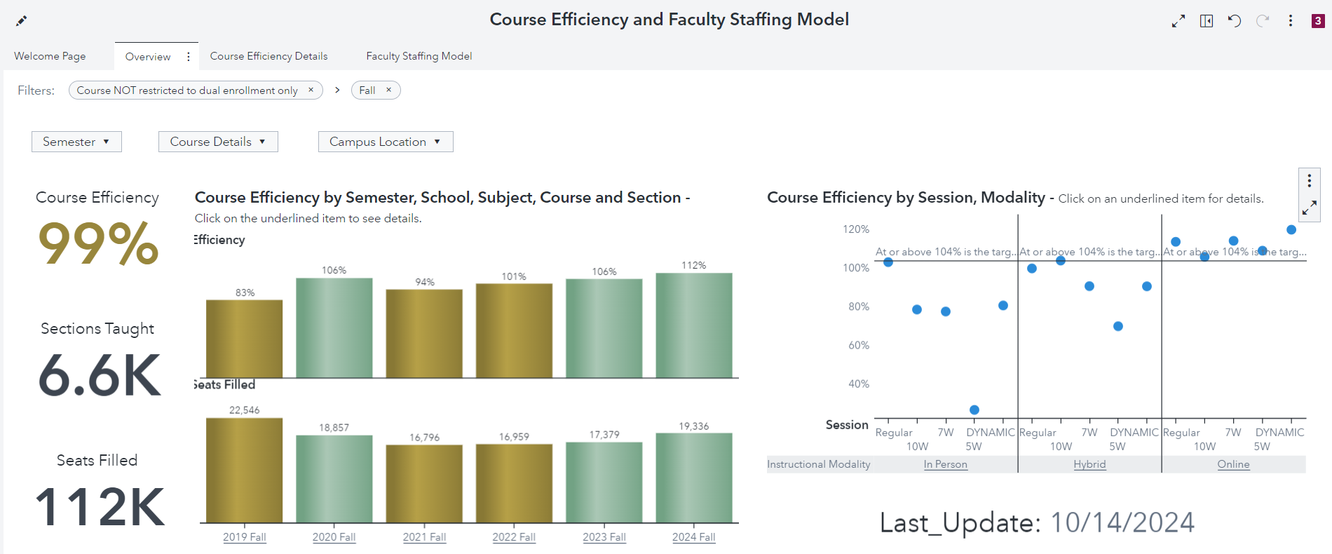
Course Efficiency and Faculty Staffing Model
+6% increase in course efficiency from fall 2023 to fall 2024

Slide 11
Our “AHA” Moment
Notes:
A conversation on the strategic use of data.

Slide 12
Thank you!

